Slide 1

NZS 8134:2021 Ngā Paerewa Health and Disability Services standard
Public and private overnight hospital inpatient services
Notes:
NZS 8134:2021 Ngā Paerewa Health and Disability Services standard Public and private overnight hospital inpatient services

Slide 2
Manatū Hauora Ministry of Health karakia
Whāia, whāia, whāia,
Ngā uaratanga o te Manatū Hauora.
Ko te manaakitanga
Ko te kaitiakitanga
Ko te whakapono
Ko te kōkiri ngātahi
Kia tae atu tātou ki pae tata, ki pae tawhiti, ki Pae Ora.
Kia tūturu ka whakamaua kia tīna, tīna!
Haumi e, hui e! Tāiki ē!
Let us jointly pursue the values of the Ministry of Health
We take care of each other
We create an environment for our people to thrive
We work in good faith
And we move forward together
If we do this, we will lay hold of distant horizons and those near to us, and we will create a thriving future for all people
Notes:
Please join us for the Ministry of Health Karakia
Whāia, whāia, whāia,
Ngā uaratanga o te Manatū Hauora.
Ko te manaakitanga
Ko te kaitiakitanga
Ko te whakapono
Ko te kōkiri ngātahi
Kia tae atu tātou ki pae tata, ki pae tawhiti, ki Pae Ora.
Kia tūturu ka whakamaua kia tīna, tīna!
Haumi e, hui e! Tāiki ē!

Slide 3
Whakataukī
He waka eke noa
A canoe which we are all in with no exception
Notes:
He waka eke noa
A canoe which we are all in with no exception

Slide 4
Nau mai, haere mai - Welcome
Notes:
Nau mai haere mai welcome to NZS8134:2021 Ngā Paerewa Health and disability Services Standard public and private overnight hospital inpatient services presentation

Slide 5
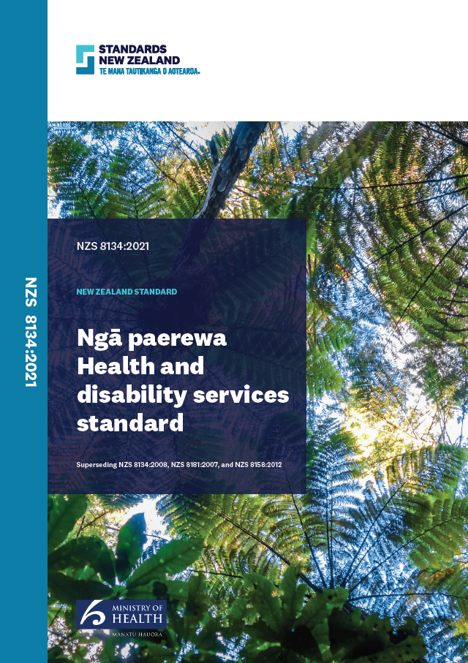
How we are communicating
You spoke, we listened
Based on sector feedback, the updated Ngā Paerewa Health and disability services standard (NZS 8134:2021) implementation sessions have been pre-recorded
Please direct any questions or queries to certification@health.govt.nz
Notes:
A decision was made to pre-record these presentations based on previous feed back from live online sessions.
Please use the certification@health.govt.nz email for any direct queries about this presentation or the standard

Slide 6
Focus for this session
Overview – The journey
Principles based approach, Te Tiriti o Waitangi
What has changed?
  The standards mapped
  Sector specific guidance
How will these changes influence auditing?
Links to resources and templates
Next steps
Maria Clarke
Te Apārangi
Notes:
The purpose of this presentation is to give public and private overnight hospital inpatient service providers an overview of Ngā Paerewa. This includes a summary of the standards mapping and how the transition to the new and partially new standards will be initially audited. There are also links to resources and templates for your reference.

Slide 7
Overview - The Journey
Review and Development was undertaken in partnership with Standards NZ and Te Apārangi
Developed by the sector for the sector
Involved over 300 representatives from the sector
Principles based approach
Approved by Minister Andrew Little 24 June 2021 and will come into effect 28 February 2022
Dr Ashley Bloomfield introduces Ngā Paerewa the 2021 Health and Disability Standard
Notes:
The Health and Disability Services (Safety) Act 2001 (the Act) requires regular review of the Health and Disability Services Standards and Fertility Services Standard. Reviewing these standards regularly is important to ensure that they reflect the services being provided today and continue to work for health practitioners, service providers, and those using the services and their whānau.
In 2017, the Ministry of Health (the Ministry) began a significant review and consultation process with the health and disability sector, including health practitioners, service providers, advocacy and support groups, iwi, and the people and whānau who use our health and disability services.
The review provided the health and disability sector with the chance to ensure the standards are flexible enough to reflect current accepted best practice and Incorporate changing ways of delivering high-quality care and support.
For more information about the review process, visit the Ministry website.
Other Standards Included in the review:
The home and community support sector has some crossover into these services. For this reason, the Home and Community Support Sector Standard (NZS 8158:2012) was considered as part of this review, with the support of the sector.
Following the passing of the Abortion Legislation Act 2020, the role of regulating abortion services transferred to the Ministry. Its Interim Standards for Abortion Services in New Zealand were also included in the review.

Slide 8
Updated Ngā Paerewa Health and Disability Services Standards updated NZS 8134:2021
Te Tiriti guidance has been added throughout the entire standard
Sector Guidance has been produced to support the implementation of
NZS 8134:2021
Notes:
Following agreement from the sector, the 2021 standard combined the following four standards into one, which significantly reduces duplication and variation across the services:
Health and Disability Services Standards (NZS 8134:2008)
Fertility Services Standard (NZS 8181:2007)
Home and Community Support Sector Standard (NZS 8158:2012)
Interim Standards for Abortion Services in New Zealand.
The 2021 standard applies to over 650 different providers, including fertility services, primary birthing centres, hospices, overnight hospital inpatient services (public and private), age-related residential care services, residential mental health and addiction services and disability services. This standard is also fit for use by home and community support services and abortion service providers in Aotearoa New Zealand.
The Standards Approval Board approved the 2021 standard on 4 May 2021. The Minister of Health approved the 2021 standard for use under the Act on 24 June 2021. The 2021 standard will become mandatory on 28 February 2022. Pdf of the standard is available to download from Standards New Zealand website, the Ministry has funded the ability for the sector to download the pdf without cost. A hard copy can be ordered from the Standards NZ website for $68.00
It is intended that the standard will remain dynamic, reflecting current accepted practice. Regular reviews will be undertaken to ensure that this is achieve and that the standard remains appropriate and applicable.
The standard represents the minimum requirements necessary for a fair and equitable health and disability services that aim to improve the experience and outcomes of people and whānau and reduce care variation. The revised standard reflects the fundamental shifts towards more person-and whānau-centred health and disability services; people are empowered to make decisions about their own care and support in order to achieve their goals, and there is a stronger focus on outcomes for people receiving support care.
The standard has been arranged into six sections;

Slide 9
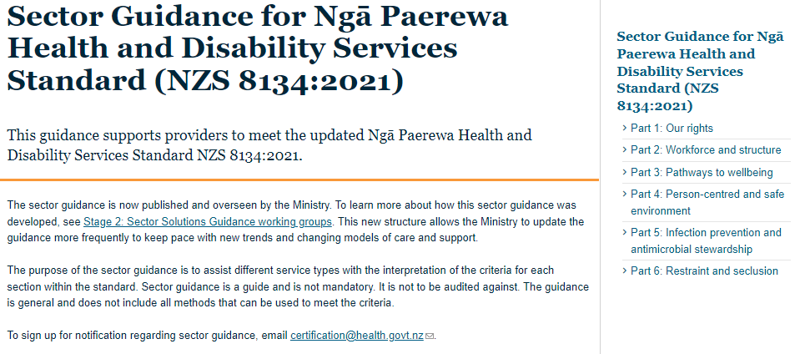
Sector Guidance
Notes:
The six sections of the standard are;
Section 1 Our rights
Section 2 Workforce and structure
Section 3 Pathways to wellbeing
Section 4 Person-centred and safe environment
Section 5 Infection prevention and antimicrobial stewardship;
Section 6 Restraint and seclusion
Sector guidance aligned with the six sections of the standard can be found online on the Ministry of Health website

Slide 10
Te Tiriti o Waitangi - Principles based approach
The Standards review provided the opportunity for both the health sector and ministry to align with Whakamaua: the Māori Health Action Plan 2020-2025 and Te Tiriti responsibilities.
Training and Support
Ngā Paerewa Refreshed Te Tiriti o Waitangi Related Requirements – session for service Providers
E-Learning Te Tiriti module currently in development for February 2022
Notes:
The health and disability system is committed to fulfilling the special relationship between Māori and the Crown under Te Tiriti o Waitangi (Te Tiriti). Ensuring that this standard supports health and disability service providers to honour Te Tiriti was a key aim of the most recent iteration NZS 8134.
The principles of Te Tiriti o Waitangi, as articulated by the Courts and the Waitangi Tribunal, provide the framework for how we will meet our obligations under Te Tiriti in our day to day work. The 2019 Hauora report recommends the following principles for the primary health care system, These principles are applicable to the wider health and disability system, the five principles that apply to our work are;
Tino Rangatiratianga: The guarantee of tino rangatiratanga which provides for Māori self-determination and mana motuhake in the design, delivery and monitoring of health and disability services.
Equity: The principle of equity, which requires the Crown to commit to achieving equitable health outcome for Māori.
Active Protection: The principle of active protection, which requires the Crown to act, to the fullest extent practicable, to achieve equitable health and outcomes for Māori. This includes insuring that it, its agents and its Treaty partner are well informed on the extent, and nature, of both Māori health outcomes and efforts to achieve Māori health equity.
Options: The principle of options, which requires the Crown to provide for and properly resource Kaupapa Māori health and disability services. Furthermore the Crown is obliged to ensure that all health and disability services are provided in a culturally appropriate way that recognises and supports the expression of hauora Māori models of care.
Partnership: The principle of partnership, which requires the Crown and Māori to work in partnership in the governance, design, delivery and monitoring of health and disability services. Māori must be co-designers, with the Crown, of the primary health system for Māori.
The principles-based approach informed the revision of the standard. These principles guided discussions, informed debate and helped achieve consensus during the sector-wide engagement phase of this review. The five Principles are:
Achieving Maori health equity – Te Tiriti principles (kāwanatanga, tino rangatiratanga, ōritetanga) underpin the standards;
(b) Accessible health and disability services – People and whānau, regardless of culture, gender, disability, age, sexual orientation, ethnicity, economic situation, or geographic location, have timely and equitable access to appropriate health and disability support services;
(c) Partners with choice and control - People and whānau using health and disability services have their rights upheld to make choices about their care, and equity of health and wellbeing outcomes. This principle can be rephrased as ‘Nothing about us without us’;
(d) Best practice through collaboration – Appropriate care includes understanding of the lived experience of people and whānau and shared decision making with them;
(e) Standards that increase positive life outcomes – the standards reflect the interaction between people and whānau and their health, wellbeing, and disability support needs

Slide 11
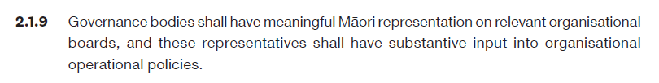
One of the key things the 2021 standard is asking for is greater evidence that service providers are developing/strengthening and maintaining relationships with Māori
Māori Health Data and Stats
Auditors to look for evidence that service providers are forming relationships or connecting with the local ‘mana whenua’ of their region: Māori maps.
Non punitive timeframe of 12-18 months for implementation.
Previously: HDSS 1.1.4.6
Updated: NPHDSS 2.1.9
Notes:
As you can see in the slide, the review has provided more definition in criteria descriptions to assist strengthening and maintaining relationships with Māori, with Auditors able to look for measurable evidence as opposed to the previous standards subjective intentions.

Slide 12
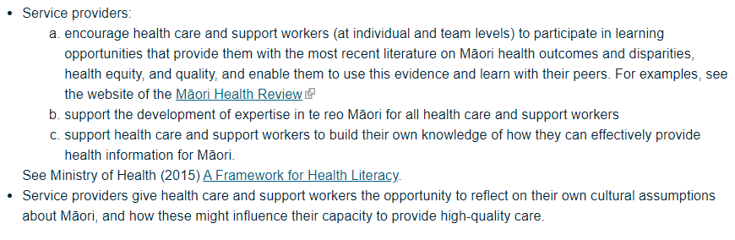
2.3 Whakahaerenga Ratonga Service Management
2.3.6 Service providers shall establish environments that encourage collecting and sharing of high-quality Māori health information.
Māori Health review
A Framework for Health Literacy
The Sector Guidance for Ngā Paerewa Health and Disability Service Standard (NZS 8134:2021) also provides good direction on what to look for
Notes:
Bringing greater fidelity on statistics for Māori health will support realising the intent of the principles by being able to monitor service delivery and assist in measuring equitable health outcomes for Māori including where any service delivery improvements are required

Slide 13
Ngā Paerewa NZS8134:2021 and the Auditing Process
HealthCERT administers The Health and Disability Services (Safety) Act 2001 (the Act) on behalf of the Director-General of Health (the DG) through a certification audit framework.
Designated auditing agencies (DAAs) assess the safety of service delivery for people accessing services by completing audits against the health and disability services standard (NZS 8134:2008).
Audits provide an opportunity to identify risk in a service. DAAs submit certification audit reports to HealthCERT that review the report and use a risk matrix to determine the service provider’s audit certification period (1-5 years).
Service providers must also undergo a surveillance audit, which occurs in the middle of the certification period. Surveillance audits are against a smaller set of criteria.
Notes:
Providers are required to apply to HealthCERT for certification and be audited against the health and disability services standard.
These audits are conducted by an auditing agency designated under the Act (referred to as designated auditing agencies (DAAs)).
Audits assess the providers compliance with the Standards to ensure residents are provided with safe and appropriate care.
These audits are submitted to HealthCERT for review, to make a determination of the certification period for the provider and any other conditions they will be subject to. A certification period ranges from 1 to 5 years.
In addition to the main certification audit, providers must also undergo a surveillance audit, which occurs in the middle of the certification period.
Surveillance audits are against a core set of high impact standards, as well as reassessing any shortfalls from the previous audit.

Slide 14
Ngā Paerewa NZS8134:2021 Auditing types and purpose
CERTIFICATION | SURVEILIANCE | PARTIAL PROVISIONAL | PROVISIONAL
An audit against all criteria within the standard | A midpoint audit against a subset of criteria | An audit against a subset of the standard focused on a new environment | An audit against all criteria that occurs when a certified provider is selling
Determines the certification period (1-5 years) | Audits differ slightly by service type | E.g. Extension to a facility | These audits result in a 1-year period of certification
Notes:
The Designated Auditing Agency Handbook prescribes the HealthCERT certification audit framework. There are four types of audits.
Certification: an audit against all criteria within the standard. This audit determines the certification period (1-5 years).
b. Surveillance: a midpoint audit against a subset of criteria. These differ slightly by service type:
i. aged residential care and residential mental health and addiction services are unannounced and completed ‘three months either side’ of the certification period’s midpoint date
ii. providers funded by the Ministry’s Disability Support Services use developmental evaluations in lieu of our surveillance audit template
iii. all other service providers are announced audits and completed ‘by’ a midpoint date
c. Partial provisional: an audit against a subset of the standards focussed on a new environment. They are undertaken when:
a certified provider:
• builds an extension
• adds rooms in an established facility
• adds a certified service type (eg. certified for rest home services and wants to add hospital services).
ii. an uncertified provider has built a new facility.
d. Provisional: an audit against all criteria that occurs when a certified provider is selling. These audits result in a 1-year period of certification.

Slide 15
Surveillance Audit criteria for Ngā Paerewa
The surveillance audit criteria for Ngā Paerewa includes the majority of the 2008 Standard surveillance criteria.
Te Tiriti related requirements have been included in the Ngā Paerewa surveillance audit criteria to ensure cultural safety is maintained. This will also support service providers to plan for and implement these new requirements.
Surveillance audit criteria applies to service types in accordance with Ngā Paerewa’s criteria application framework
Notes:
The surveillance audit criteria for Ngā Paerewa includes the majority of the 2008 Standard surveillance criteria.
Te Tiriti related requirements have been included in the Ngā Paerewa surveillance audit criteria to ensure cultural safety is maintained. This will also support service providers to plan for and implement these new requirements.
Surveillance audit criteria applies to service types in accordance with Ngā Paerewa’s criteria application framework

Slide 16
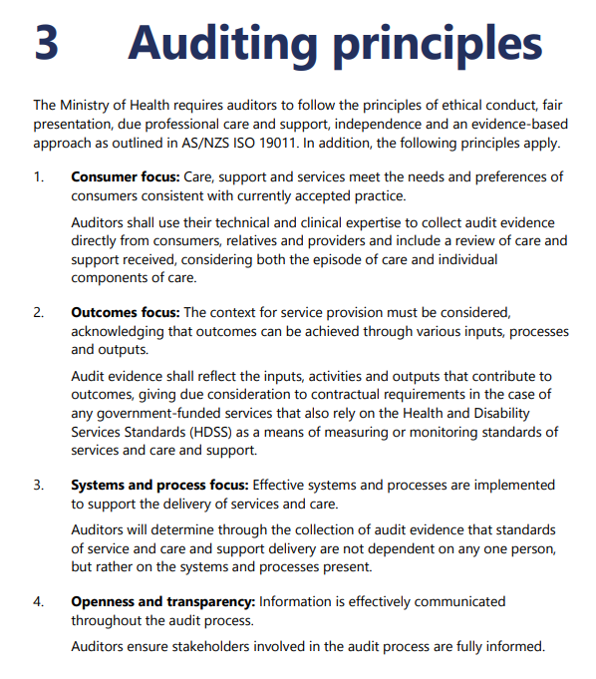
What does this mean for service providers?
Your decision-making should continue to be underpinned by the auditing principles
Continue to use your judgement to determine the intention of the criteria is being followed
The criteria is outlined in the Public and Private Overnight Hospital Inpatient summary of NZS8134:2021 aligned with the sector guidance in support of the Standards.

Slide 17
Implementation Transition
HealthCERT/The Ministry of Health are committed to a non-punitive approach to transitioning to the new standard
There will be grace periods for partially mapped and unmapped/new criteria
Notes:
We are taking a non-punitive approach to transitioning to the Ngā Paerewa requirements
(a) The proposed implementation transition plan’s non-punitive approach includes the following:
Mapped criteria will continue to be audited as usual and attainment aligned with
current audit practice.
(b) A short grace period will be implemented for partially mapped criteria. The provider
will be required to evidence what actions they are taking, or plan to take, to
implement these criteria. This grace period will be applicable for 6 to12 months.
Where there is no evidence of planning or progression at audit, the provider will
receive a ‘Partially Attained’ (PA) attainment, with a relevant risk rating assigned,
including a timeframe for mitigation.
(c) A longer grace period will be implemented for criteria that is unmapped/new. This
grace period may be 12 to 18 months. The provider will be required to evidence a
documented action plan and implementation strategies to meet the criteria. Where
there is no evidence of planning or progression at audit, the provider will receive a PA
attainment, with a relevant risk rating assigned, including a timeframe for mitigation.

Slide 18
Transitioning to new and partially mapped criteria
MAPPED | PARTIALLY MAPPED/NEW CRITERIA | UNMAPPED/NEW
Criteria are explicit or intended in the previous standard | Are not explicit in the previous standard and/or have a new component added in Ngā Paerewa | Criteria are new and cannot be mapped to current requirements
Audit as usual | Grace period 6 – 12 months | Grace period 12 - 18 months
Notes:
(a) Mapped - Criteria are explicit or intended in the previous standard
Continue to be audited as usual and attainment alighted with current audit practice
(b) Partially mapped/new criteria - Are not explicit in the previous standard and/or have a new component added in Ngā Paerewa
Short grace period will be implemented for partially mapped criteria. The provider will be required to evidence what actions they are taking, or plan to take, to implement these criteria. This grace period will be applicable for 6 – 12 months. Where there is no evidence of planning or progression at audit, the provider will receive a ‘Partially Attained’ (PA) attainment, with a relevant risk rating assigned, including a timeframe for mitigation
(c) Unmapped/new – Criteria are new and cannot be mapped to current requirements
A longer grace period will be implement for criteria that is unmapped/new. This grace period may be 12 to 18 months. The provider will be required to evidence documented action plan and implementation strategies to meet criteria. Where there is no evidence of planning or progression at audit, the provider will receive a PA attainment, with a relevant risk rating assigned, including a timeframe for mitigation

Slide 19
Changes to the Standards Mapped
Official mapping analysis compares Ngā Paerewa Health and Disability Services Standard NZS 8134:2021 (‘the 2021 standard’) with the previous standards, showing which criteria have changed and which have stayed the same
Mapping the Health and Disability Services Standards (NZS 8134:2008) criteria to the 2021 standard indicates that 72 percent of the criteria directly map, 11 percent partially map and 17 percent do not map
The standards mapping summary will support public and private overnight hospital inpatient services to plan and prepare for meeting the updated audited requirements in the 2021 standard
Notes:
Official mapping analysis compares previous standards, with the 2021 standard showing which criteria have changed and which have stayed the same
Mapping the previous criteria to the 2021 standard for public and private overnight hospital inpatient services that 72 percent of the criteria directly map, 11 percent partially map and 17 percent do not map
To support providers to plan and prepare for updated audit requirements the standards criteria application framework gives a sector specific overview

Slide 20
Ngā Paerewa Reference Documents
Please open the documents below for your reference and review during the following standards summary
Standards Mapping Analysis 2021 listed on Manatū Haurora Ministry of Health Website
Ngā Paerewa Health and disability services standard NZS8134:2021 listed on Standards New Zealand Website
Designated Auditing Agency Handbook listed on Manatū Hauora Ministry of Health Website
Notes:
Please take a moment to open the documents listed on this slide to review during the subsection, partially new and new criteria summary

Slide 21
Public and Private Overnight Hospital Inpatient Services
Summary
 | Public and private overnight hospital inpatient services
Total Applicable criteria (out of 221) | 199
Total mapped criteria (%) | 72%
Total partially mapped (%) | 11%
Total not mapped | 17%
Notes:
Criteria between the existing and updated standards fit into three different categories.
Mapped: The 2021 criteria directly map to criteria in one of the four standards. The criteria are either the same or have the same intent. The wording may differ slightly.
Partially mapped: The 2021 criteria partially align to criteria in one of the four standards. The 2021 criteria are either similar to current criteria or are the same as most of the current criteria, but with an additional element. The wording is likely to differ because the 2021 criteria reflect current accepted best practice.
Not mapped: The 2021 criteria do not map to criteria in any of the four standards. The criteria are new to the 2021 standard and have been added to assure safe services to New Zealanders that reflect updated models of care.

Slide 22
NZS 8134:2021 Section 1: Ō TĀTOU MOTIKA | OUR RIGHTS
Public and private overnight hospital inpatient services
1.1
Pae ora Healthy futures
1.2
Ola Manuia of Pacific Peoples in Aotearoa
1.3
My rights during service delivery
1.4
I am treated with respect
1.5
I am protected from abuse
1.6
Effective communication occurs
1.7
I am informed to make choices
1.8
I have the right to complain
1.9 Health and wellbeing of children born as a result of, and people accessing, reproductive technology services
1.10 Requirement of donation and surrogacy
Notes:
For public and private overnight hospital inpatient services only 8 subsections and 47 criteria are applicable out of the 10 subsections and 56 criteria

Slide 23
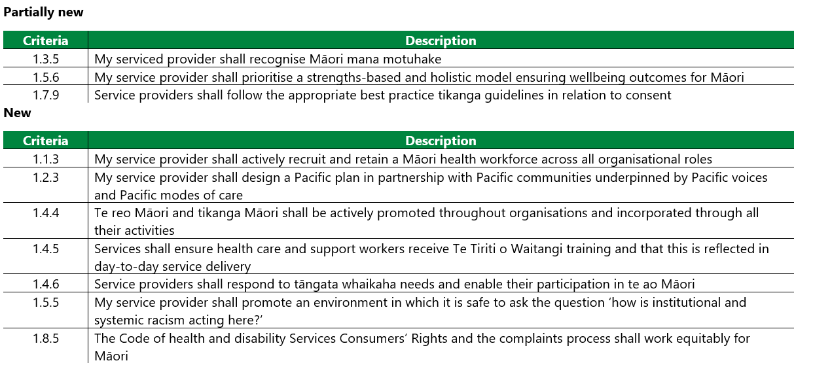
Section 1: Ō TĀTOU MOTIKA | OUR RIGHTS
Outcome 1: People receive safe services of an appropriate standard that comply with consumer rights legislation. Services are provided in a manner that is respectful of people’s rights, facilitates informed choice, minimises harm, and upholds cultural and individual values and beliefs.
Notes:
Of the 47 criteria that are applicable in section one 3/47 criteria are partially new, and 7/47 criteria are new

Slide 24
NZS 8134:2021 Section 2: HUNGA MAHI ME TE HANGANGA | WORKFORCE AND STRUCTURE
2.1 Governance
2.2
Quality and risk
2.3
Service Management
2.4
Health care and support workers and their availability
2.5 Information
Public and private overnight hospital inpatient services
Notes:
Of section twos 5 subsections and 43 criteria
All subsections and 40/43 criteria are applicable

Slide 25
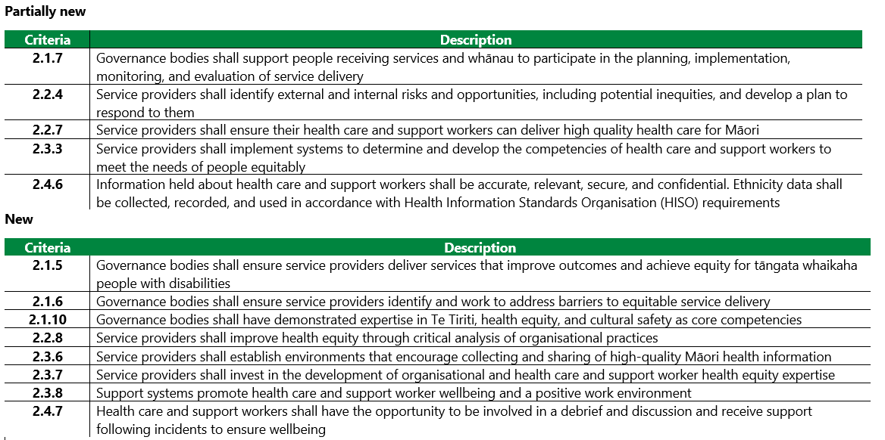
Section 2: HUNGA MAHI ME TE HANGANGA | WORKFORCE
AND STRUCTURE
Outcome 2: People receive quality services through effective governance and a supported workforce
Notes:
5/40 criteria are partially new, and 8/40 criteria are new

Slide 26
NZS 8134:2021 Section 3: NGĀ HUARAHI KI TE ORANGA | PATHWAYS TO WELLBEING
Public and private overnight hospital inpatient services
3.1
Entry and declining entry
3.2
My pathway to wellbeing
3.3
Individual activities
3.4
My medication
3.5
Nutrition to support wellbeing
3.6
transition, transfer, and discharge
3.7 Electroconvulsive Therapy
3.8
Obtaining and caring for gametes and embryos
Notes:
For section 3 please refer to the standard to see which of the criteria an subsections apply to either public or private hospitals

Slide 27
Section 3: NGĀ HUARAHI KI TE ORANGA | PATHWAYS TO WELLBEING
Outcome 3: People participate in the development of their pathway to wellbeing, and receive timely assessment, followed by services that are planned, coordinated, and delivered in a manner that is tailored to their needs
Notes:
7/8 subsections for section three are applicable

Slide 28
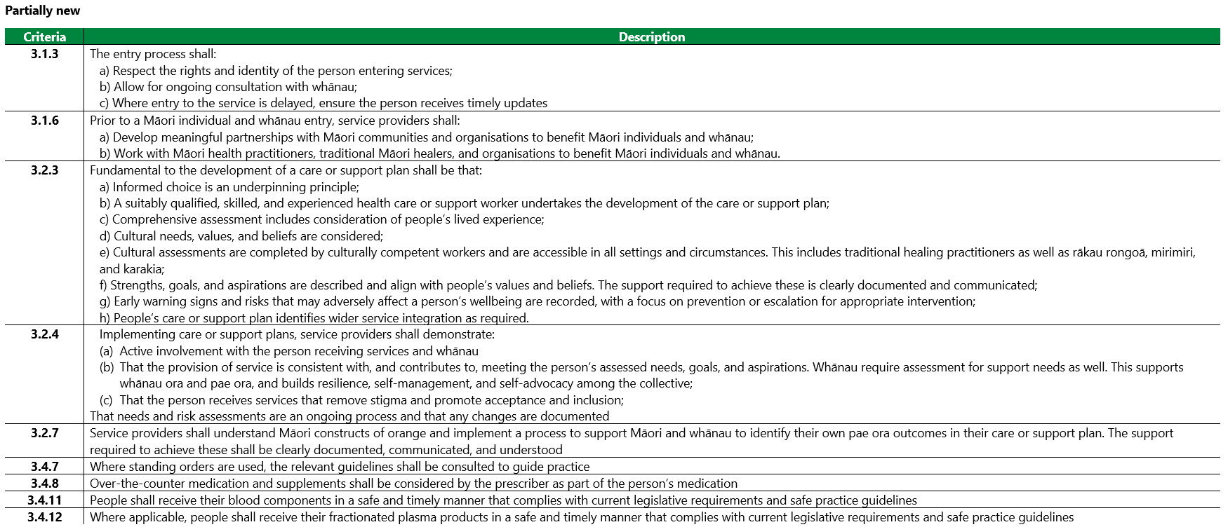
Section 3: NGĀ HUARAHI KI TE ORANGA | PATHWAYS TO WELLBEING
Notes:
Of the applicable criteria 9 are partially new

Slide 29
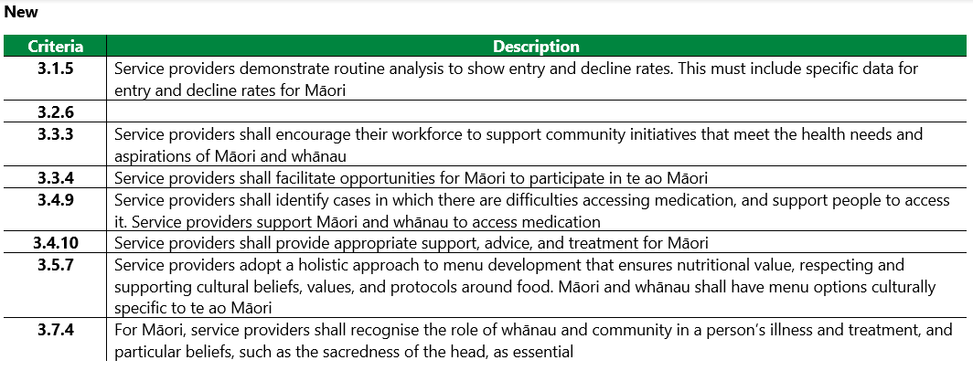
Section 3: NGĀ HUARAHI KI TE ORANGA | PATHWAYS TO WELLBEING
Outcome 3: People participate in the development of their pathway to wellbeing, and receive timely assessment, followed by services that are planned, coordinated, and delivered in a manner that is tailored to their needs
Notes:
Of the applicable criteria 8 are new

Slide 30
NZS 8134:2021 Section 4: TE ARO KI TE TANGATA ME TE TAIAO HAUMARU | PERSON-CENTRED AND SAFE ENVIRONMENT
Public and private overnight hospital inpatient services
4.1
The Facility
4.2
Security of people and workforce
Notes:
For section four both of the subsections and all of the criteria are applicable

Slide 31
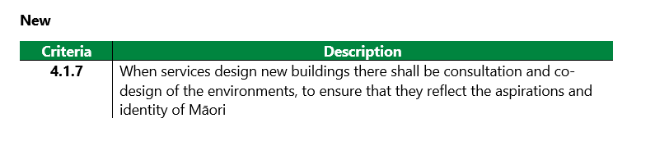
Section 4: TE ARO KI TE TANGATA ME TE TAIAO HAUMARU | PERSON-CENTRED AND SAFE ENVIRONMENT
Outcome 4: Health and disability services are provided in a safe environment appropriate to the age and needs of the people receiving services that facilitates independence and meets the needs of people with disabilities
Notes:
Only 1/15 criteria are new

Slide 32
NZS 8134:2021 Section 5: TE KAUPARE POKENGA ME TE KAITIAKITANGA PATU HUAKITA | INFECTION PREVENTION AND ANTIMOCROBIAL STEWARDSHIP
Public and private overnight hospital inpatient services
5.1
Governance
5.2
The infection prevention programme and implementation
5.3
Antimicrobial Stewardship
5.4
Surveillance of health care associated infection
5.5 Environment
Notes:
Of the 5 subsections and 30 criteria in section five
All subsections and criteria are applicable

Slide 33
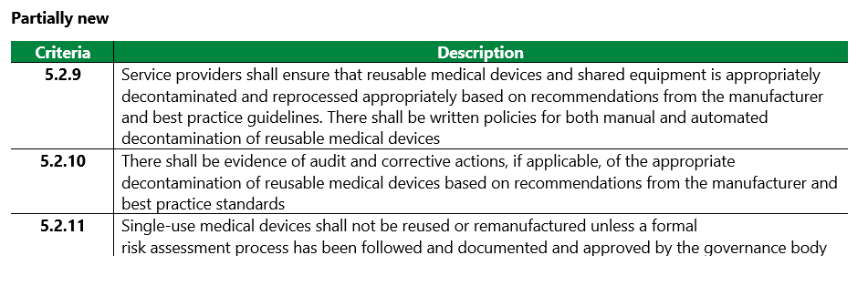
Section 5: TE KAUPARE POKENGA ME TE KAITIAKITANGA PATU HUAKITA | INFECTION PREVENTION AND ANTIMOCROBIAL STEWARDSHIP
Outcome 5: Health and disability service providers’ infection prevention (IP) and antimicrobial stewardship (AMS) strategies define a clear vision and purpose, with quality of care, welfare, and safety at the centre. The IP and AMS programmes are up to date and informed by evidence and are an expression of a strategy that seeks to maximise quality of care and minimise infection risk and adverse effects from antibiotic use, such as antimicrobial resistance.
Notes:
3/30 criteria are partially new

Slide 34
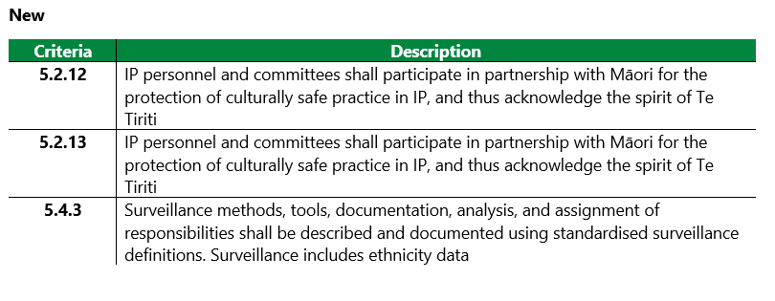
Section 5: TE KAUPARE POKENGA ME TE KAITIAKITANGA PATU HUAKITA | INFECTION PREVENTION AND ANTIMOCROBIAL STEWARDSHIP
Outcome 5: Health and disability service providers’ infection prevention (IP) and antimicrobial stewardship (AMS) strategies define a clear vision and purpose, with quality of care, welfare, and safety at the centre. The IP and AMS programmes are up to date and informed by evidence and are an expression of a strategy that seeks to maximise quality of care and minimise infection risk and adverse effects from antibiotic use, such as antimicrobial resistance.
Notes:
and 3/30 are new

Slide 35
NZS 8134:2021 Section 6: HERE TARATAHI | RESTRAINT AND SECLUSION
Public and private overnight hospital inpatient services
6.1
A process of restraint
6.2
Safe restraint
6.3
Quality review of restraint
6.4
Seclusion
Notes:
Please refer to the standard for section six to determine which of the subsections and criteria apply to public or private hospitals

Slide 36
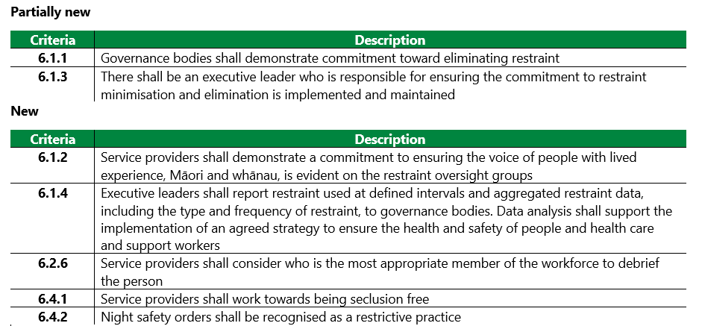
Section 6: HERE TARATAHI | RESTRAINT AND SECLUSION
Outcome 6: Services shall aim for a restraint and seclusion free environment, in which people’s dignity and mana are maintained
Notes:
Of the applicable criteria only 2 are partially new and 5 are new

Slide 37
Key points reviewed
We are all learning the refreshed requirements of Ngā Paerewa Health and disability services standard together
Evidence is required that service providers are forming relationships or connecting with the local ‘mana whenua’ of their region
HealthCERT/The Ministry of Health are committed to a non-punitive approach to transitioning to the new standard. There will be grace periods for partially mapped and unmapped/new criteria
Notes:
In summary, We are all learning the refreshed requirements of Ngā Paerewa Health and disability services standard together
Evidence is required that service providers are forming relationships or connecting with the local ‘mana whenua’ of their region
HealthCERT/The Ministry of Health are committed to a non-punitive approach to transitioning to the new standard. There will be grace periods for partially mapped and unmapped/new criteria

Slide 38
Links to resources and templates
NZS 8134:2021 Ngā Paerewa Health and Disability Services Standard
Sector Guidance for Ngā Paerewa Health and Disability Services Standard (NZS 8134:2021)
Standards Mapping Analysis 2021
Designated Auditing Agency Handbook
Manatū Hauora Ministry of Health action plans and strategies
  He Korowai Oranga: New Zealand’s Māori Health Strategy
  Whakamaua: Māori Health Action Plan 2020-2025
  Whāia te Ao Mārama 2018 to 2022: the Māori Disability Action Plan
Māori Health review Link
A Framework for Health Literacy Link
Regional reference for mana whenua: Māori maps.
Notes:
This slide contains a summary of the references used in this presentation

Slide 39
The journey continues : He waka eke noa
A canoe which we are all in with no exception
Ngā Paerewa has been designed with the sector for the sector
Sector are encouraged to provide feedback certification@health.govt.nz
Monitoring and evaluation phase will run until May 2024
Training and development as part of the continuous improvement cycle
Resources are being developed for the learning journey
The Standards have been designed to be responsive to the sectors needs
Notes:
So where to from here?
Nga Paerewa has been designed with the sector for the sector and the sector are strongly encouraged to provide feedback
There will be a Monitoring and evaluation phase that will run until May 2024
And we see training and development as part of the continuous improvement cycle during the monitoring and evaluation phase
To support this resources are being developed for the learning journey for the sector by the ministry
The Standards have been designed to be responsive to the sectors needs

Slide 40
Pātai? Questions?
Please direct any questions or queries to certification@health.govt.nz
Notes:
For further information on resources, or any questions about this presentation or the standards please contact the HealthCERT team via the certification@health.govt.nz email

Slide 41
Ngā Mihi Nui
Notes:
Thank you for watching this presentation

Slide 42
Manatū Hauora Ministry of Health karakia
Whāia, whāia, whāia,
Ngā uaratanga o te Manatū Hauora.
Ko te manaakitanga
Ko te kaitiakitanga
Ko te whakapono
Ko te kōkiri ngātahi
Kia tae atu tātou ki pae tata, ki pae tawhiti, ki Pae Ora.
Kia tūturu ka whakamaua kia tīna, tīna!
Haumi e, hui e! Tāiki ē!
Let us jointly pursue the values of the Ministry of Health
We take care of each other
We create an environment for our people to thrive
We work in good faith
And we move forward together
If we do this, we will lay hold of distant horizons and those near to us, and we will create a thriving future for all people
Notes:
In closing please join us for the Manatū Hauora Ministry of Health karakia
Whāia, whāia, whāia,
Ngā uaratanga o te Manatū Hauora.
Ko te manaakitanga
Ko te kaitiakitanga
Ko te whakapono
Ko te kōkiri ngātahi
Kia tae atu tātou ki pae tata, ki pae tawhiti, ki Pae Ora.
Kia tūturu ka whakamaua kia tīna, tīna!
Haumi e, hui e! Tāiki ē!

