Slide 1
NZS 8134:2021 Ngā paerewa Health and disability services standard
Te Tiriti o Waitangi related criteria
for auditors
Thank you for attending this session. We will start at 1:35pm

Slide 2
Manatū Hauora Ministry of Health karakia
Whāia, whāia, whāia,
Ngā uaratanga o te Manatū Hauora.
Ko te manaakitanga
Ko te kaitiakitanga
Ko te whakapono
Ko te kōkiri ngātahi
Kia tae atu tātou ki pae tata, ki pae tawhiti, ki Pae Ora.
Kia tūturu ka whakamaua kia tīna, tīna!
Haumi e, hui e! Tāiki ē!
Let us jointly pursue the values of the Ministry of Health
We take care of each other
We create an environment for our people to thrive
We work in good faith
And we move forward together
If we do this, we will lay hold of distant horizons and those near to us, and we will create a thriving future for all people

Slide 3
Haeremai Welcome - Intro
Riana Manuel,
Chair, Te Apārangi
Chief Executive Te Korowai Hauora o Hauoraki
Maria Clarke
Member, Te Apārangi
Kaiwhakahaere Tauawhi Kainga, Hunga Whara - Homebase & ACC Manager, Te Puna Ora Mataatua

Slide 4
Housekeeping
We are recording this session
All sessions will be made available on the HealthCERT page on the Ministry website
We will be publishing these slides on our website
How we will manage questions
Submit your questions throughout the presentation via the chat function.
We will be accepting questions from now until just after 12.
A member of the HealthCERT team will collate your questions and email them through to us

Slide 5
Focus for this session
New Te Tiriti Content
Context
What do I look for as an auditor?
Sector Guidance
What’s next
Questions
Maria Clarke
Te Apārangi

Slide 6
The backstory
In early 2019, attendees to standards review scoping workshops confirmed they wanted an “and, and” approach → to both:
Update the current Standard 1.4 Recognition of Māori values and beliefs
Add Te Tiriti guidance throughout the entire standard
and
Notes:
JADE To addin summary slide

Slide 7
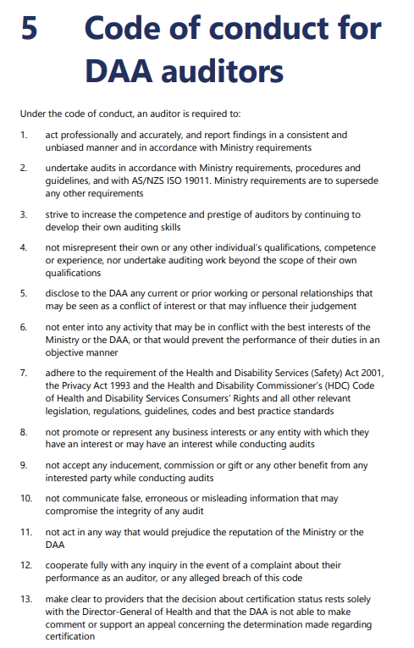
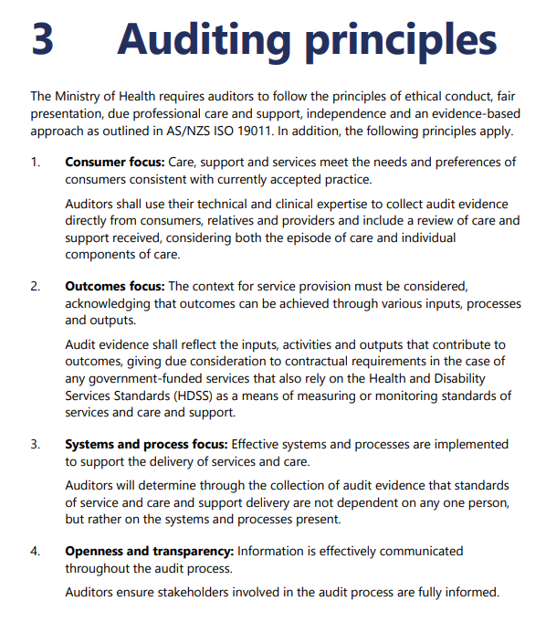
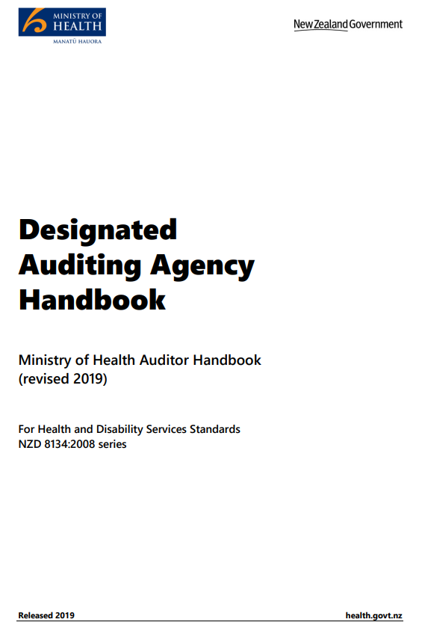
The DAA Handbook is currently being reviewed, but the[intent of the] principles and code of conduct remains the same

Slide 8
Our group, Te Apārangi, was established to direct this work of reviewing a number of criterion
Section 1.1: Pae Ora
The 34 Te Tiriti o Waitangi statements throughout Ngā Paerewa
A number of criteria throughout
This presentation is designed to understand why some of these criterion needed to be reviewed
And how they can be brought to life/evidenced

Slide 9
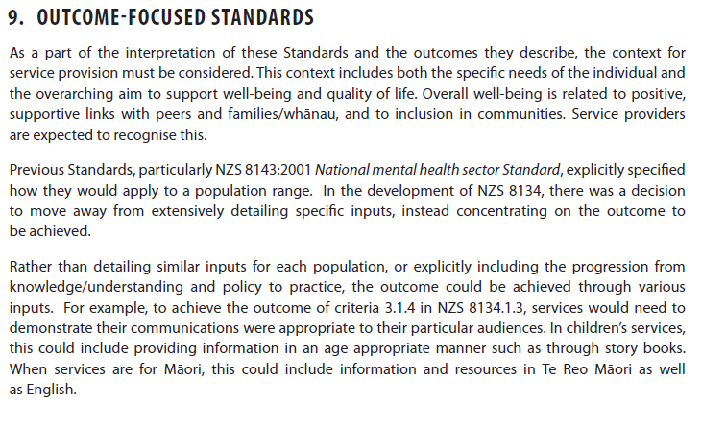
The 2008 standard is outcome-focused
HDSS 8134:2008
You are responsible with determining whether an outcome has been achieved that is appropriate to the context of the service provision

Slide 10
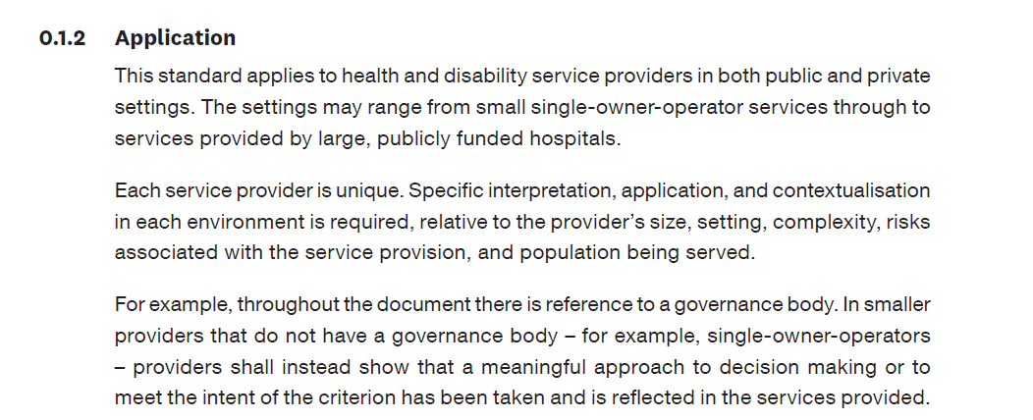
The 2021 standard is also outcome-focussed
NPHDSS 8134:2021

Slide 11
Continue to use your judgement to determine the intent of the criterion is being followed.
Your decision-making should continue to be underpinned by the auditing principles.

Slide 12
If you need further direction, there are a number of places you can go to determine the intent
Sector guidance
Tripart outcome statements
Ministry of Health action plans and strategies
He Korowai Oranga: New Zealand’s Māori Health Strategy
Whakamaua: Māori Health Action Plan 2020-2025
Whāia te Ao Mārama 2018to 2022: the Māori Disability Action Plan
DHB strategies, guidelines and action plans…

Slide 13
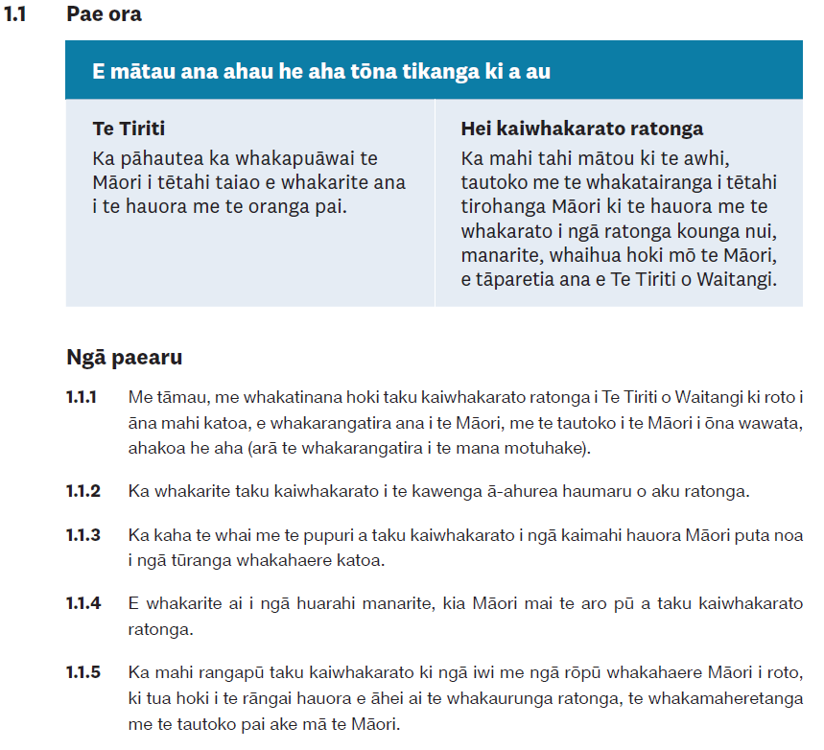
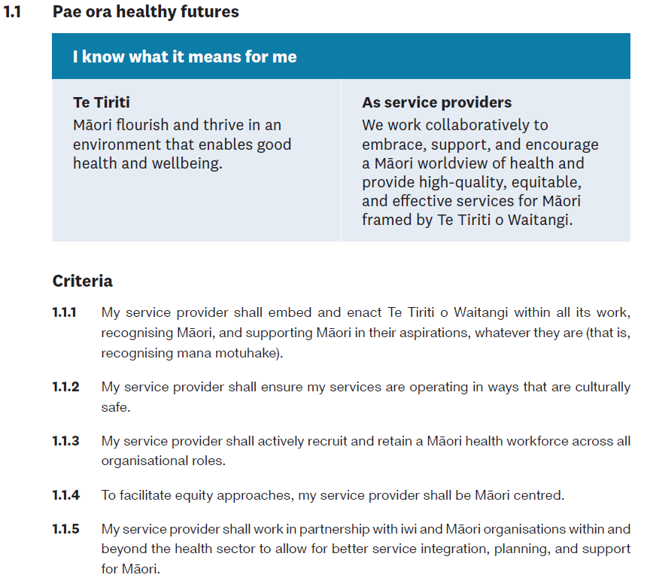
Let’s look at 1.1 Pae Ora …

Slide 14
How do we do determine compliance for this?

Slide 15
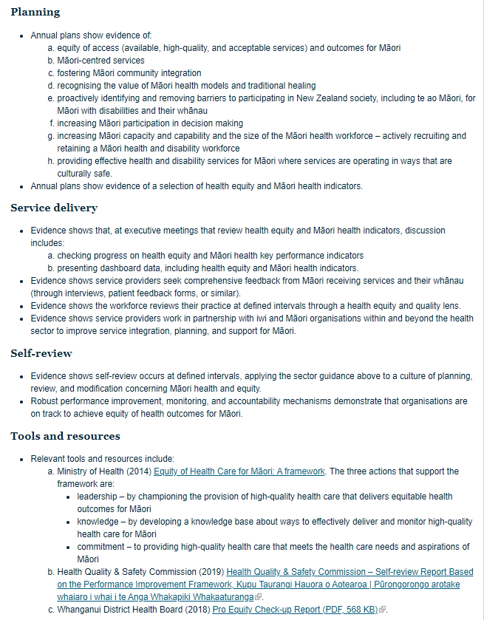
The answers are (largely) in the Sector Guidance on the Ministry’s website
With active links to frameworks and research to help guide providers and, by extension, what you should be looking for as anauditor.
This will be updated regularly to reflect the latest guidance and research in this space.
https://www.health.govt.nz/our-work/regulation-health-and-disability-system/certification-health-care-services/services-standards/nga-paerewa-health-and-disability-services-standard/sector-guidance-nga-paerewa-health-and-disability-services-standard-nzs-81342021

Slide 16
Within 1.1 Pae Ora – Ngā paereru Criteria 1.1.3 is new to HDSS users
What are some examples of what you might look for?
Notes:
See that

Slide 17
Other ideas
Establishing and maintaining links with Māori stakeholders when developing new services
Demonstrating consultation with iwi, hapū, whānau and Māori communities who have links with the service
Evaluating recommendations and the level of satisfaction with service delivery by Māori users
Evidence of initiatives undertaken directed by Māori research
eg Te Rau Ora: How to Increase the Māori Health Workforce
Recruitment process and competencies align with and reflect Te Arawhiti’s capability framework

Slide 18
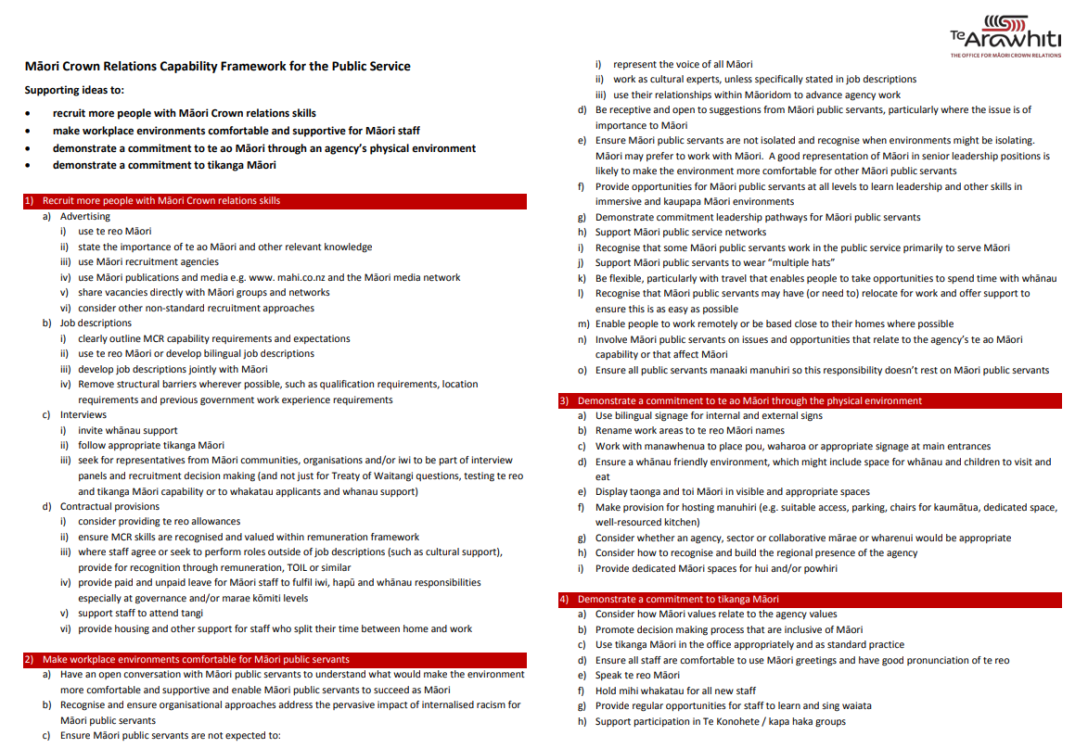
Te Arawhiti The Office for Māori Crown Relations’ capability framework also provides good steps that an organisation can be adapted and used by service providers to recruit and retain Māori staff

Slide 21
2.3 Whakahaerenga ratonga Service management
2.3.6 Service providers shall establish environments that encourage collecting and sharing of high-quality Māori health information.
The sector guidance provides good direction on what to look for

Slide 22
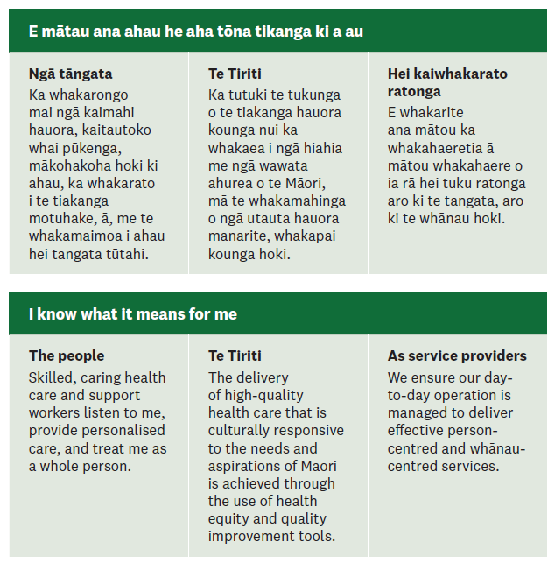
Context and intent can also be gleaned from the tripart outcome statements

Slide 23
2.3 Whakahaerenga ratonga Service management
2.3.6 Service providers shall establish environments that encourage collecting and sharing of high-quality Māori health information.
Look for evidence that health care and support workers and management are encouraged to take advantage of courses that are available

Slide 24
There are many was to engage with te reo Māori
On location classes
Te Wānanga o Aotearoa (locations nationwide)
Te Ataarangi (locations nationwide, call 0800 282 272 to find a class near you)
AUT (Auckland CBD & South Auckland)
Unitec (Auckland)
Te Whare Waatea (South Auckland)
Rutherford College (West Auckland) (fees apply)
Mangere East Community Centre (South Auckland)
Northtec (Kaitaia, Whangārei, Helensville)
Te Herenga Waka O Orewa (Silverdale)
Te Whare Wananga o Awanuiārangi (Whakatāne, Auckland, Northland)
Whitireia (Porirua, Kāpiti, Auckland)
Toi-Ohomai (Rotorua, Tokoroa)
E.I.T (Hawkes Bay, Wairoa, Ruatoria)
REAP House (Wairarapa)
UCOL (Palmerston North, Whanganui, Wairarapa)
Community Education Centre (Wellington) (fees apply)
Nelson Marlborough Institute of Technology NMIT (Marlborough, Nelson)
Ara Institute of Canterbury (Christchurch, Timaru, Ashburton, Oamaru)
University of Canterbury (Christchurch)
Southern Institute of Technology (Gore, Invercargill, Queenstown)
Otago University (Dunedin) (fees apply)
Risingholme Community Centre (Christchurch) (fees apply)
Hagley College (Christchurch) (fees apply)
www.health.govt.nz
www.tpk.govt.nz

Slide 25
More reo resources
Taupānga ako reo | Language learning apps
Pepeha - a tool to help you prepare your pepeha
Kupu - Uses the camera in your phone to instantly translate objects into te reo Māori.
Pāpapa / He aha tēnei – Interactive app for teaching children and caregivers basic Te Reo
uTalk Classic Learn Māori - App for absolute basics
He Kupu I Kore – App for building vocabulary
Arapū Māori – App that teaches the Māori alphabet
Te Pūmanawa – App for beginner learners of Te Reo
Aki Hauora – An app developed to help health professionals learn Te Reo as well as medical terms
Te Kete Māori – NZTE App to introduce users to Māori culture, key phrases, customs, and songs
Puna – An app totally in Te Reo designed as a tool for children or beginners
Tipu Te Reo Māori – Interactive app to learn basic words and phrases
Kura – Game style app for intermediate level speakers to increase knowledge of Te Reo and mātauranga Māori
Te Whanake – App includes all of Te Whanake’s resources and has four levels of learning
He rauemi ipurangi | Online resources
Te Kura – The Correspondence School
Te Wānanga o Aotearoa
Te Wānanga o Raukawa
Victoria University
Te Whanake
Tōku Reo
Whitireia
Otago University
Memrise
Kupu O Te Rā

Slide 26
One of the key things the 2021 standard is asking for is greater evidence that service providers are developing/strengthening and maintaining relationships with Māori
Current: HDSS 1.1.4.6
Updated: NPHDSS 2.1.9
Look for evidence that service providers are forming relationships or connecting with the local ‘mana whenua’ of their region: Māori maps.
ADD IWI DATA

Slide 27
Question for the audience
What evidence might you look for that could demonstrate a small ARC provider (~15 bed) has established relationships with local mana whenua, iwi, or Māori communities?
How might this evidence be different from what you might expect from a large ARC provider (with over 15 premises across the country and >300 beds)?

Slide 28
Remember…
This is a moving feast
An evolving space that will grow and develop
Example: Health and Disability System Transformation
We are all learning the refreshed requirements of Ngā paerewa Health and disability services standard together
HealthCERT/The Ministry of Health are committed to a non-punitive approach to transitioning to the new standard. There will be grace periods for partially mapped and unmapped/new criteria!

Slide 29
Pātai?

Slide 30
What’s next

Slide 31
Indicative Implementation timeline NZS 8134: 2021 Ngā paerewa Health & Disability Services Standard
Standard NZ Board approval
Minister of Health approves Standard
for use
Sector engagement
Online workshops
Lunchtime sessions for each section
Piloting the 2021 Standard
Targeted sessions & conferences
Targeted workshops based on feedback
For each service type (eg ARC, RESDIS)
DAAs
People, whānau, consumer organisations
Māori health providers
28 February 2022
Standard in effect
May 2021
Jun
2021
Jul
2021
Aug 2021
Sep 2021
Oct 2021
Nov 2021
Dec 2021
Jan 2022
Feb 2022
Mar
2022
Notes:
Jade to speak to (if you want this at all!)

Slide 32
Indicative Implementation timeline NZS 8134: 2021 Ngā paerewa Health & Disability Services Standard
Developing an online eLearning module
Will amend sector guidance following the pilot
DAA Handbook currently being updated
Standard NZ Board approval
Minister of Health approves Standard
for use
Sector engagement
Online workshops
Lunchtime sessions for each section
Piloting the 2021 Standard
Targeted sessions & conferences
Targeted workshops based on feedback
For each service type (eg ARC, RESDIS)
DAAs
People, whānau, consumer organisations
Māori health providers
28 February 2022
Standard in effect
May 2021
Jun
2021
Jul
2021
Aug 2021
Sep 2021
Oct 2021
Nov 2021
Dec 2021
Jan 2022
Feb 2022
Mar
2022
Notes:
Jade to speak to (if you want this at all!)

Slide 33
Thank you for joining!

Slide 34
Manatū Hauora Ministry of Health karakia
Whāia, whāia, whāia,
Ngā uaratanga o te Manatū Hauora.
Ko te manaakitanga
Ko te kaitiakitanga
Ko te whakapono
Ko te kōkiri ngātahi
Kia tae atu tātou ki pae tata, ki pae tawhiti, ki Pae Ora.
Kia tūturu ka whakamaua kia tīna, tīna!
Haumi e, hui e! Tāiki ē!
Let us jointly pursue the values of the Ministry of Health
We take care of each other
We create an environment for our people to thrive
We work in good faith
And we move forward together
If we do this, we will lay hold of distant horizons and those near to us, and we will create a thriving future for all people

Slide 35
Notes

Slide 36
Our group, Te Apārangi, was established to direct this work
Section 1.1: Pae Ora
The 34 Te Tiriti o Waitangi statements throughout Ngā Paerewa
Criterion 1.4.4
Criterion 1.4.5
Criterion 1.4.6
Criterion 1.5.6
Criterion 1.7.9
Criterion 1.8.5
Criterion 2.1.5
Criterion 2.1.9
Criterion 2.1.10
Criterion 2.2.7
Criterion 2.2.8
Criterion 2.3.6
Criterion 2.3.7
Criterion 3.1.5
Criterion 3.1.6
Criterion 3.2.3 (d) (e)
Criterion 3.2.6
Criterion 3.2.7
Criterion 3.3.3
Criterion 3.3.4
Criterion 3.4.9
Criterion 3.4.10
Criterion 3.5.7
Criterion 3.6.3
Criterion 3.7.4
Criterion 3.8.8
Criterion 5.2.12
Criterion 5.2.13
Criterion 5.4.5
Criterion 6.1.6
Criterion 6.2.2
Criterion 6.4.6

Slide 37
… some of it is not new
Criterion 1.1.1
Criterion 1.1.2
Criterion 1.1.3
Criterion 1.1.4
Criterion 1.1.5
Criterion 1.4.4
Criterion 1.4.5
Criterion 1.4.6
Criterion 1.5.6
Criterion 1.7.9
Criterion 1.8.5
Criterion 2.1.5
Criterion 2.1.9
Criterion 2.1.10
Criterion 2.2.7
Criterion 2.2.8
Criterion 2.3.6
Criterion 2.3.7
Criterion 3.1.5
Criterion 3.1.6
Criterion 3.2.3 (d) (e)
Criterion 3.2.6
Criterion 3.2.7
Criterion 3.3.3
Criterion 3.3.4
Criterion 3.4.9
Criterion 3.4.10
Criterion 3.5.7
Criterion 3.6.3
Criterion 3.7.4
Criterion 3.8.8
Criterion 5.2.12
Criterion 5.2.13
Criterion 5.4.5
Criterion 6.1.6
Criterion 6.2.2
Criterion 6.4.6
Key:
Mapped

Slide 38
… some of it is partially new
Criterion 1.1.1
Criterion 1.1.2
Criterion 1.1.3
Criterion 1.1.4
Criterion 1.1.5
Criterion 1.4.4
Criterion 1.4.5
Criterion 1.4.6
Criterion 1.5.6
Criterion 1.7.9
Criterion 1.8.5
Criterion 2.1.5
Criterion 2.1.9
Criterion 2.1.10
Criterion 2.2.7
Criterion 2.2.8
Criterion 2.3.6
Criterion 2.3.7
Criterion 3.1.5
Criterion 3.1.6
Criterion 3.2.3 (d) (e)
Criterion 3.2.6
Criterion 3.2.7
Criterion 3.3.3
Criterion 3.3.4
Criterion 3.4.9
Criterion 3.4.10
Criterion 3.5.7
Criterion 3.6.3
Criterion 3.7.4
Criterion 3.8.8
Criterion 5.2.12
Criterion 5.2.13
Criterion 5.4.5
Criterion 6.1.6
Criterion 6.2.2
Criterion 6.4.6
Key:
Mapped
Partially mapped

Slide 39
… some of it is new to only some of you
Criterion 1.1.1
Criterion 1.1.2
Criterion 1.1.3
Criterion 1.1.4
Criterion 1.1.5
Criterion 1.4.4
Criterion 1.4.5
Criterion 1.4.6
Criterion 1.5.6
Criterion 1.7.9
Criterion 1.8.5
Criterion 2.1.5
Criterion 2.1.9
Criterion 2.1.10
Criterion 2.2.7
Criterion 2.2.8
Criterion 2.3.6
Criterion 2.3.7
Criterion 3.1.5
Criterion 3.1.6
Criterion 3.2.3 (d) (e)
Criterion 3.2.6
Criterion 3.2.7
Criterion 3.3.3
Criterion 3.3.4
Criterion 3.4.9
Criterion 3.4.10
Criterion 3.5.7
Criterion 3.6.3
Criterion 3.7.4
Criterion 3.8.8
Criterion 5.2.12
Criterion 5.2.13
Criterion 5.4.5
Criterion 6.1.6
Criterion 6.2.2
Criterion 6.4.6
Key:
Mapped
Partially mapped
Mapped for some service types – unmapped for others

