Slide 1
NZS 8134:2021 Ngā paerewa Health and disability services standard
Te Tiriti o Waitangi related criteria
for service providers
Thank you for attending this session. We will start at 11:35am

Slide 2
Manatū Hauora Ministry of Health karakia
Whāia, whāia, whāia,
Ngā uaratanga o te Manatū Hauora.
Ko te manaakitanga
Ko te kaitiakitanga
Ko te whakapono
Ko te kōkiri ngātahi
Kia tae atu tātou ki pae tata, ki pae tawhiti, ki Pae Ora.
Kia tūturu ka whakamaua kia tīna, tīna!
Haumi e, hui e! Tāiki ē!
Let us jointly pursue the values of the Ministry of Health
We take care of each other
We create an environment for our people to thrive
We work in good faith
And we move forward together
If we do this, we will lay hold of distant horizons and those near to us, and we will create a thriving future for all people

Slide 3
Haeremai Welcome - Intro
Riana Manuel,
Chair, Te Apārangi
Chief Executive
Te Korowai Hauora o Hauoraki
Maria Clarke
Member, Te Apārangi
Kaiwhakahaere Tauawhi Kainga, Hunga Whara - Homebase & ACC Manager,
Te Puna Ora Mataatua

Slide 4

Housekeeping
We are recording this session
  All sessions will be made available on the HealthCERT page on the Ministry website
We will be publishing these slides on our website
How we will manage questions
  Submit your questions throughout the presentation via the chat function.
  We will be accepting questions from now until just after 12.
  A member of the HealthCERT team will collate your questions and email them through to us

Slide 5
Focus for this session
New Te Tiriti Content
  Context
  What does this mean for me as a provider?
Sector Guidance
What’s next
Answering your questions
Maria Clarke
Te Apārangi

Slide 6
… before we dive too far into the detail
This is a moving feast
An evolving space that will grow and develop
  Example: Health and Disability System Transformation
We are all learning the refreshed requirements of Ngā paerewa Health and disability services standard together
HealthCERT/The Ministry of Health are committed to a non-punitive approach to transitioning to the new standard. There will be grace periods for partially mapped and unmapped/new criteria!

Slide 7
The backstory
In early 2019, attendees to standards review scoping workshops confirmed they wanted an “and, and” approach → to both:
Update the current Standard 1.4 Recognition of Māori values and beliefs
Add Te Tiriti guidance throughout the entire standard
and

Slide 8
Our group, Te Apārangi, was established to direct this work of reviewing a number of criterion
Section 1.1: Pae Ora
The 34 Te Tiriti o Waitangi statements throughout Ngā Paerewa
A number of criteria throughout
This presentation is designed to understand why some of these criterion needed to be reviewed
And how they can be brought to life/evidenced

Slide 9
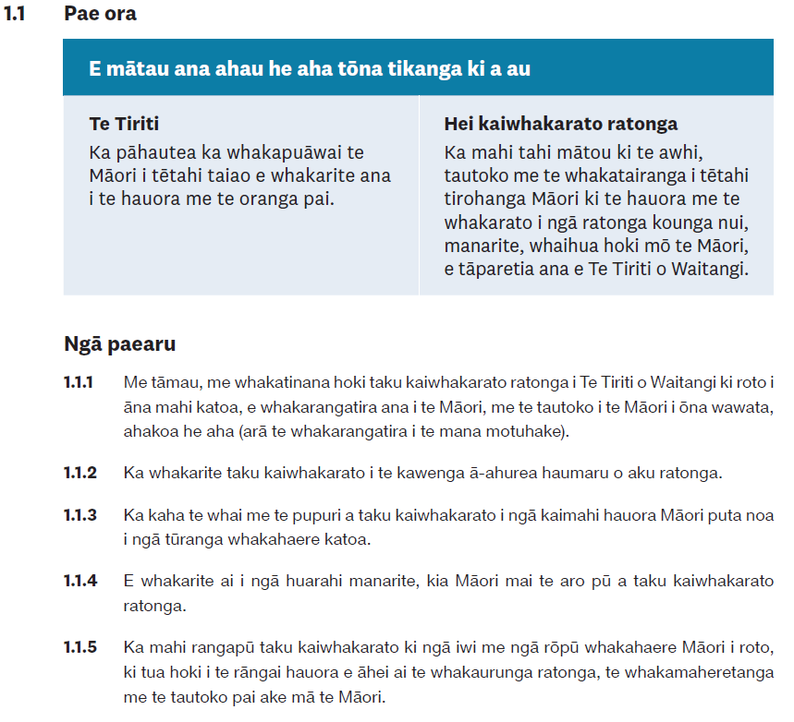
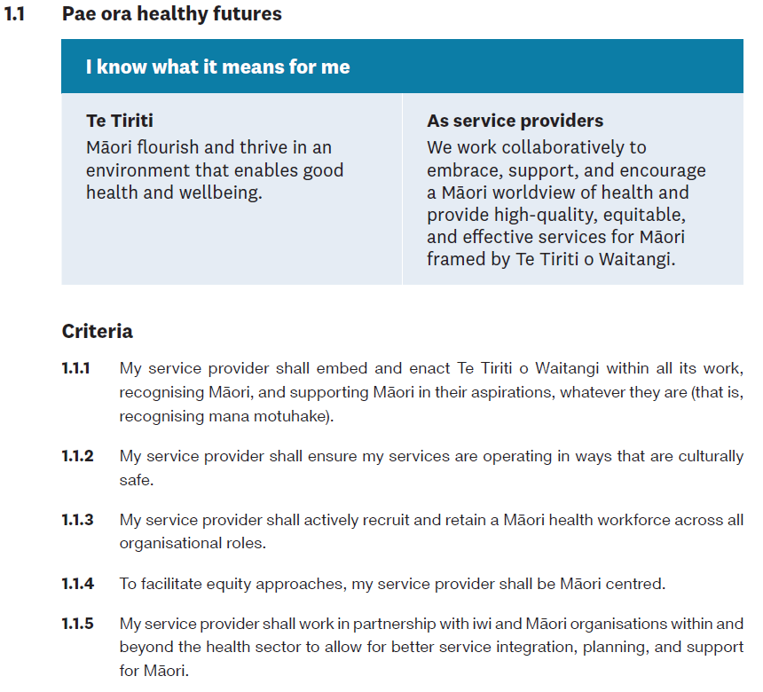
Let’s look at 1.1 Pae Ora …

Slide 10



How do we do and then demonstrate that?

Slide 11
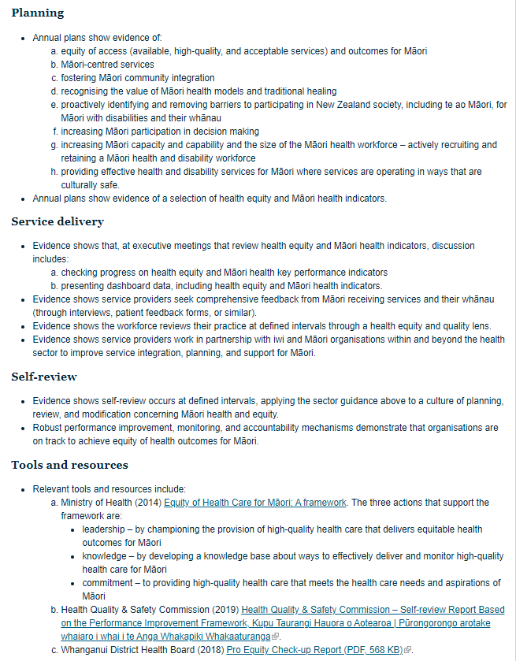
The answers are (generally) in the Sector Guidance on the Ministry’s website
With active links to frameworks and research to help guide you and your organisation.
This will be updated regularly to reflect the latest guidance and research in this space.
https://www.health.govt.nz/our-work/regulation-health-and-disability-system/certification-health-care-services/services-standards/nga-paerewa-health-and-disability-services-standard/sector-guidance-nga-paerewa-health-and-disability-services-standard-nzs-81342021

Slide 12
1.4 E whakakautetia ana ahu I am treated with respect
1.4.6 Service providers shall respond to tāngata whaikaha needs and enable their participation in te ao Māori
Sector Guidance
Service providers demonstrate an awareness of tāngata whaikaha needs and enable them to access te ao Māori
You can access your local resources as well – kaumātua, marae, rōpū to find out this information and how you can support Māori in your service
Notes:
Admittedly there is not much guidance here – but as with the current standard, there is not necessarily going to be guidance for every single criteria. There are, of course, ways that you can go about exploring what might demonstrate this. For example, a good option for this criteria could be to go to the Ministry’s website for disabled people.

Slide 13
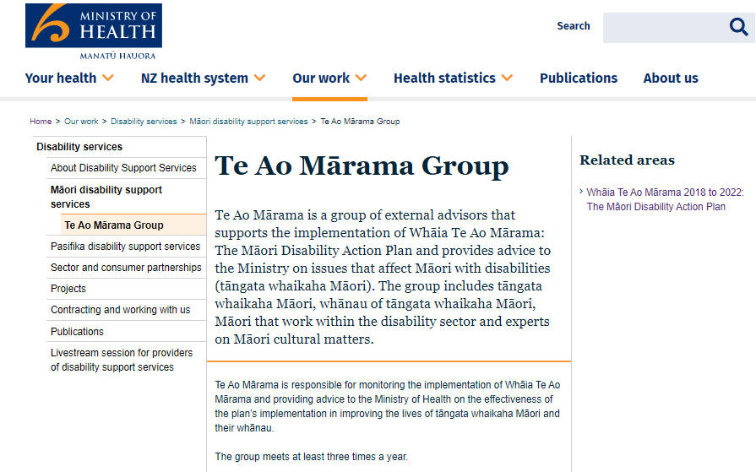


Explore other sources

Slide 14
1.8 Nōku te mana ki te tuku amuamu I have the right to complain
1.8.5 The Code of Health and Disability Consumers’ Rights and the complaints process shall work equitably for Māori
Sector Guidance
The Code of Health and Disability Services Consumers’ Rights is visible, and available in te reo Māori, English, and New Zealand Sign Language in accessible formats.
Service providers use their best efforts to verify Māori and whānau understand their rights.
Communication and information about the complaints process are easy for all people to access, understand, and use.
The complaint resolution policy and procedures, forms, surveys, guidelines, and resources are designed to adequately capture complaints made by Māori. Service providers consider:
  any under-reporting of complaints from Māori
  the level of access Māori have to the complaints process
The service provider asks: what works best for Māori?
Notes:
Sometimes good guidance

Slide 15
2.1 Hunga mahi me te hanganga Workforce and structure
2.1.10 Governance bodies shall have demonstrated expertise in Te Tiriti, health equity, and cultural safety as core competencies.
Sector Guidance
Evidence shows demonstrated expertise in Te Tiriti, health equity, and cultural safety, and that training of governance body members occurs.
There is an executive leader on the governance body who champions Māori health equity as an integral component of quality.
Useful tools include:
  Ministry of Health (2014) Equity of Health Care for Māori: A framework
  Medical Council of New Zealand and Te Ohu Rata O Aotearoa, the Māori Medical Practitioners Association (2019) ‘He Ara Hauora Māori: A pathway to Māori health equity’
  New Zealand Medical Council (2019) ‘Statement on cultural safety’.
Notes:
Follow link to demonstrate how there are more resources to be accessed

Slide 16
2.2 Kounga me te mōrearea Quality and risk
2.2.8 Service providers shall improve health equity through critical analysis of organisational practices
Sector Guidance
Service providers establish policies, practices, and training that will support and require their health care and support workers to review at defined intervals their organisation’s practice through a health equity and quality lens.
This may include prioritised use of the Health Equity Assessment Tool (HEAT) or equivalent and appropriate equity tools and ethnicity data improvement tools, such as:
  Signal L, Martin J, Cram F, et al (2008) The Health Equity Assessment Tool: A user's guide
  Ministry of Health (2013) Primary Care Ethnicity Data Audit Toolkit
  Ministry of Health (2014) Equity of Health Care for Māori: A framework.

Slide 17
3.1 Te urunga me te whakakore urunga Entry and declining entry
3.1.5 Service providers demonstrate routine analysis to show entry and decline rates. This must include specific data for entry and decline rates for Māori.
Sector Guidance
Service providers demonstrate routine analysis of entry and decline rates for Māori. Where ethnicity data is incomplete and inconsistent, service providers improve data quality to make such analysis routine.
Service providers identify and implement supports to benefit Māori and whānau.

Slide 18
3.2 Taku huarahi ki te oranga My pathway to wellbeing
3.2.6 Service providers shall:
  Together with tāngata whaikaha, develop policies and procedures that ensure tāngata whaikaha and whānau participate in service development;
  Deliver services that give tāngata whaikaha choice and control over their supports;
  Remove barriers that prevent tāngata whaikaha and whānau from independently accessing information.

Slide 19
Also check with your local DHB
Have local guidelines, which can be used/referenced by service providers
You don’t have to reinvent the wheel sometimes it’s just going out to find the bits you need
Māori health units within DHBs can also be a great resource
Ex) Waikato DHB has:
  Te Korowai Waiora Health System Plan
  Te Manawa Taki Regional Equity Plan 2020-2023
  Rapua Te Ara Matua Equity Report 2021
Notes:
Add

Slide 20

3.3 Ngā mahi takitahi Individualised activities
3.3.3 Service providers shall encourage their workforce to support community initiatives that meet the health needs and aspirations of Māori and whānau.
3.3.4 Service providers shall facilitate opportunities for Māori to participate in te ao Māori
Engage with iwi data on Te Whata
Find your local ‘mana whenua’
https://tewhata.io/
https://maorimaps.com/
Te Whata is a data platform created by iwi for iwi– designed by Te Kāhui Raraunga (TKR) whose aim is to:
enhance the social, cultural, environmental, and economic well-being of Māori;
enable iwi, hapū and whānau Māori to access, collect and use Māori data to measure and identify areas of Māori well-being requiring change;
support innovation and research that advances the use of Māori data;
educate Māori on the benefits of collection and use of Māori data; and
promote and advance opportunities for iwi, hapū and whānau Māori to share knowledge and information relating to collection and use of Māori data.
While there is Sector Guidance for 3.3.4, both criteria provide the opportunity for your organisation to connect with the local ‘mana whenua’ of your region.
Notes:
Follow Te Whata link and demonstrate how it works.

Slide 21
3.4 Aku rongoā My medication
3.4.9 Service providers shall identify cases in which there are difficulties accessing medication, and support people to access it. Service providers support Māori and whānau to access medication.
3.4.10 Service providers shall provide appropriate support, advice, and treatment for Māori.
3.4.10 Sector Guidance
Service providers work in partnership with Māori to verify that:
  the appropriate support is in place
  advice is timely and easily accessed
  treatment is prioritised to achieve better health outcomes.
Notes:
There is no sector guidance for 3.4.9, but directing whānau to relevant consumer advocacy websites and resources could be a good option

Slide 22
3.7 Haumanu whakahikororo Electroconvulsive therapy
3.7.4 For Māori, service providers shall recognise the role of whānau and community in a person’s illness and treatment, and particular beliefs, such as the sacredness of the head, as essential.
Sector Guidance
Where whānau want to be more closely involved in and consulted on specific cultural preferences and concerns, service providers carefully consider the indications for ECT and all aspects of the process and explain them in a culturally sensitive manner. Te Whare Tapa Whā and other Māori models of care are relevant. Information should also include alternative treatment options.
Service providers could use the Takarangi Competency Framework to guide best practice in culturally safe care.

Slide 23
3.8 Te whiwhi me te tiaki ngā pūtau hemame ngā kikiri Obtaining and caring for gametes and embryos
3.8.8 Service providers shall ensure the design of the facility and the delivery of service are culturally and clinically safe for Māori who visit and use the service.
Sector Guidance
Service providers are Māori-centred. For example, they provide sufficient information focused on Māori needs, sharing the experiences of Māori men and women with fertility treatment.
Service providers monitor access of their services by ethnicity to verify service provision is appropriate and achieves equitable access and outcomes for Māori.
Service providers have suitable processes and procedures to verify their day-stay services are culturally and clinically safe.

Slide 24
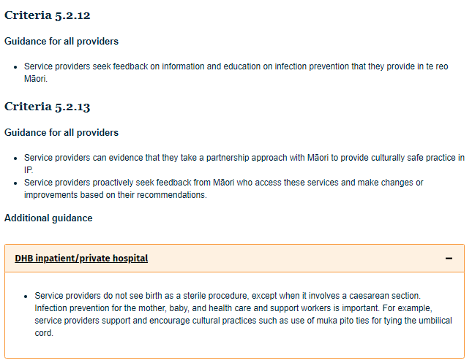
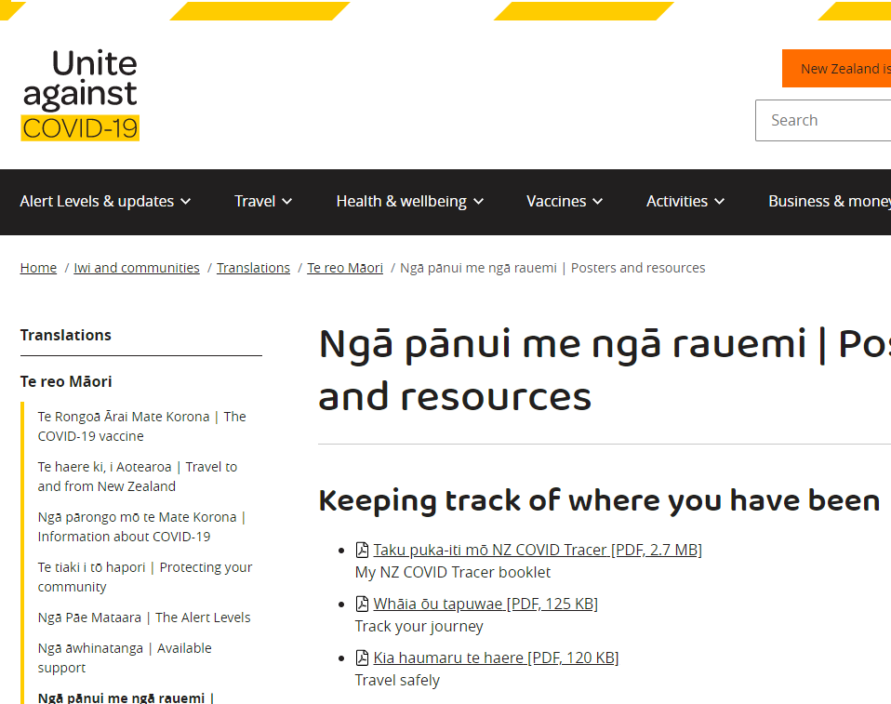
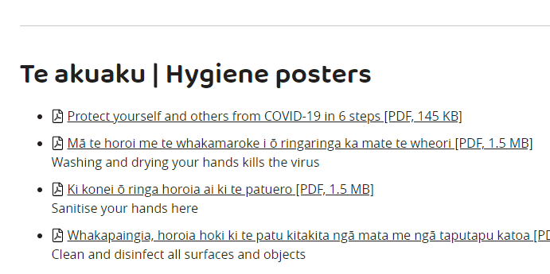
5.2 Te hōtaka kaupare pokenga me te whakatinanatanga The infection prevention programme and implementation
5.2.12 Service providers shall provide educational resources that are available in te reo Māori and are accessible and understandable for Māori accessing services.
5.2.13 IP personnel and committees shall participate in partnership with Māori for the protection of culturally safe practice in IP, and thus acknowledge the spirit of Te Tiriti.
While there is Sector Guidance, there are other good places to go, particularly for resources about IP in many languages, including te reo Māori.

Slide 25
Pātai?

Slide 26
What’s next

Slide 27
Indicative Implementation timeline
NZS 8134: 2021 Ngā paerewa Health & Disability Services Standard
Standard NZ Board approval
Minister
of Health approves Standard
for use
Sector engagement
Online workshops
Lunchtime sessions for each section
Piloting the 2021 Standard
Targeted sessions & conferences
Targeted workshops based on feedback
For each service type (eg ARC, RESDIS)
DAAs
People, whānau, consumer organisations
Māori health providers
28 February 2022
Standard in effect
May 2021
Jun
2021
Jul
2021
Aug 2021
Sep 2021
Oct 2021
Nov 2021
Dec 2021
Jan 2022
Feb 2022
Mar
2022
Notes:
Jade to speak to (if you want this at all!)

Slide 28
Indicative Implementation timeline
NZS 8134: 2021 Ngā paerewa Health & Disability Services Standard
Developing an online eLearning module
Will amend sector guidance following the pilot
Standard NZ Board approval
Minister
of Health approves Standard
for use
Sector engagement
Online workshops
Lunchtime sessions for each section
Piloting the 2021 Standard
Targeted sessions & conferences
Targeted workshops based on feedback
For each service type (eg ARC, RESDIS)
DAAs
People, whānau, consumer organisations
Māori health providers
28 February 2022
Standard in effect
May 2021
Jun
2021
Jul
2021
Aug 2021
Sep 2021
Oct 2021
Nov 2021
Dec 2021
Jan 2022
Feb 2022
Mar
2022
Notes:
Jade to speak to (if you want this at all!)

Slide 29
Thank you for joining!

Slide 30
Manatū Hauora Ministry of Health karakia
Whāia, whāia, whāia,
Ngā uaratanga o te Manatū Hauora.
Ko te manaakitanga
Ko te kaitiakitanga
Ko te whakapono
Ko te kōkiri ngātahi
Kia tae atu tātou ki pae tata, ki pae tawhiti, ki Pae Ora.
Kia tūturu ka whakamaua kia tīna, tīna!
Haumi e, hui e! Tāiki ē!
Let us jointly pursue the values of the Ministry of Health
We take care of each other
We create an environment for our people to thrive
We work in good faith
And we move forward together
If we do this, we will lay hold of distant horizons and those near to us, and we will create a thriving future for all people

Slide 31
Notes

Slide 32
… some of it is not new
Criterion 1.1.1
Criterion 1.1.2
Criterion 1.1.3
Criterion 1.1.4
Criterion 1.1.5
Criterion 1.4.4
Criterion 1.4.5
Criterion 1.4.6
Criterion 1.5.6
Criterion 1.7.9
Criterion 1.8.5
Criterion 2.1.5
Criterion 2.1.9
Criterion 2.1.10
Criterion 2.2.7
Criterion 2.2.8
Criterion 2.3.6
Criterion 2.3.7
Criterion 3.1.5
Criterion 3.1.6
Criterion 3.2.3 (d) (e)
Criterion 3.2.6
Criterion 3.2.7
Criterion 3.3.3
Criterion 3.3.4
Criterion 3.4.9
Criterion 3.4.10
Criterion 3.5.7
Criterion 3.6.3
Criterion 3.7.4
Criterion 3.8.8
Criterion 5.2.12
Criterion 5.2.13
Criterion 5.4.5
Criterion 6.1.6
Criterion 6.2.2
Criterion 6.4.6
Key:
Mapped

Slide 33
… some of it is partially new
Criterion 1.1.1
Criterion 1.1.2
Criterion 1.1.3
Criterion 1.1.4
Criterion 1.1.5
Criterion 1.4.4
Criterion 1.4.5
Criterion 1.4.6
Criterion 1.5.6
Criterion 1.7.9
Criterion 1.8.5
Criterion 2.1.5
Criterion 2.1.9
Criterion 2.1.10
Criterion 2.2.7
Criterion 2.2.8
Criterion 2.3.6
Criterion 2.3.7
Criterion 3.1.5
Criterion 3.1.6
Criterion 3.2.3 (d) (e)
Criterion 3.2.6
Criterion 3.2.7
Criterion 3.3.3
Criterion 3.3.4
Criterion 3.4.9
Criterion 3.4.10
Criterion 3.5.7
Criterion 3.6.3
Criterion 3.7.4
Criterion 3.8.8
Criterion 5.2.12
Criterion 5.2.13
Criterion 5.4.5
Criterion 6.1.6
Criterion 6.2.2
Criterion 6.4.6
Key:
Mapped
Partially mapped

Slide 34
… some of it is new to only some of you
Criterion 1.1.1
Criterion 1.1.2
Criterion 1.1.3
Criterion 1.1.4
Criterion 1.1.5
Criterion 1.4.4
Criterion 1.4.5
Criterion 1.4.6
Criterion 1.5.6
Criterion 1.7.9
Criterion 1.8.5
Criterion 2.1.5
Criterion 2.1.9
Criterion 2.1.10
Criterion 2.2.7
Criterion 2.2.8
Criterion 2.3.6
Criterion 2.3.7
Criterion 3.1.5
Criterion 3.1.6
Criterion 3.2.3 (d) (e)
Criterion 3.2.6
Criterion 3.2.7
Criterion 3.3.3
Criterion 3.3.4
Criterion 3.4.9
Criterion 3.4.10
Criterion 3.5.7
Criterion 3.6.3
Criterion 3.7.4
Criterion 3.8.8
Criterion 5.2.12
Criterion 5.2.13
Criterion 5.4.5
Criterion 6.1.6
Criterion 6.2.2
Criterion 6.4.6
Key:
Mapped
Partially mapped
Mapped for some service types – unmapped for others

Slide 35
Today we will focus on what is new for all of you
Criterion 1.1.1
Criterion 1.1.2
Criterion 1.1.3
Criterion 1.1.4
Criterion 1.1.5
Criterion 1.4.4
Criterion 1.4.5
Criterion 1.4.6
Criterion 1.5.6
Criterion 1.7.9
Criterion 1.8.5
Criterion 2.1.5
Criterion 2.1.9
Criterion 2.1.10
Criterion 2.2.7
Criterion 2.2.8
Criterion 2.3.6
Criterion 2.3.7
Criterion 3.1.5
Criterion 3.1.6
Criterion 3.2.3 (d) (e)
Criterion 3.2.6
Criterion 3.2.7
Criterion 3.3.3
Criterion 3.3.4
Criterion 3.4.9
Criterion 3.4.10
Criterion 3.5.7
Criterion 3.6.3
Criterion 3.7.4
Criterion 3.8.8
Criterion 5.2.12
Criterion 5.2.13
Criterion 5.4.5
Criterion 6.1.6
Criterion 6.2.2
Criterion 6.4.6

