Slide 1
Nau mai, haere mai - Welcome
This presentation was pre-recorded based on sector feedback about Ngā Paerewa Health and disability Services Standard (NZS 8134:2021).
Please direct any questions or queries to certification@health.govt.nz

Slide 2
Ngā Paerewa
Claire Underwood
Principal Advisor HealthCERT
Te Kaupare Pokenga Me Te Kaitiakitanga Patu Huakita Infection Prevention & Antimicrobial Stewardship

Slide 3
Ngā Paerewa Health and Disability Services Standard NZS 8134:2021
Came into effect 28 February 2022
Approved under the Health and Disability Services (Safety) Act 2001
Replaces several other standards
The review process took over two and a half years

Slide 4
Ngā Paerewa Health and Disability Services Standard NZS 8134:2021
Format of Ngā Paerewa:
Sub-section 5.1
Section 5
5.1.1 The governance body shall identify the IP and AMS programmes as integral to the service providers’ strategic plans (or equivalent) to improve quality and ensure the safety of people receiving services and health care and support workers
Criterion 5.1.1

Slide 5
Ngā Paerewa Health and Disability Services Standard NZS 8134:2021
Key changes to Infection Control requirements
Section is now referred to as Infection Prevention and Antimicrobial Stewardship
Increased focus on clinical governance
Requirements will remain dynamic and reflect current best practice

Slide 6
Ngā Paerewa Health and Disability Services Standard NZS 8134:2021
A note on wording and definitions
'Shall' refers to requirements that are essential for compliance
'Should' refers to practices that are advised or recommended
'IP' – Infection Prevention
'AMS' – Antimicrobial Stewardship

Slide 7
Governance
Providers are unique in size, complexity and the population being served
Ngā paerewa refers to the governance body throughout the document
For smaller providers that may not have a large governance body this refers to the approach on how decisions are made
Are they meaningful, documented and communicated?

Slide 8
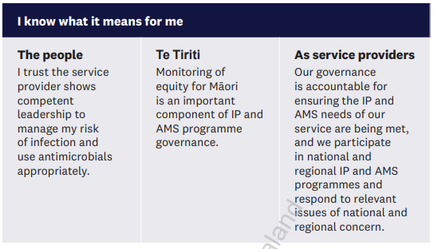
Infection Prevention and Antimicrobial Stewardship
Person centred approach

Slide 9
Te Tiriti requirements

Slide 10
Subsection 5.1
‘Our governance is accountable for ensuring the IP and AMS needs of our service are being met, and we participate in national, regional IP and AMS programmes and respond to relevant issues of national and regional concern’

Slide 11
Subsection 5.1 in Practice
There are four criterion in this subsection
5.1.1, 5.1.2, 5.1.3 and 5.1.4
Key elements of these criteria are related to governance of the IP and AMS programme
Which committee or group actions the plan or programme?
How often are the plans reviewed?
How is the committee accessing expert advice?
How are IP and AMS issues raised to governance level?
How are IP adverse events managed and reported on?

Slide 12
Subsection 5.2 in Practice
There are 13 criteria in this subsection
‘We develop and implement an infection prevention programme that is appropriate to the needs, size and scope of our services’
5.2.1 and 5.2.2
Who is responsible for doing IPC in your facility or service, do they have the knowledge to do the job and make decisions?
How is the work of IP done, how are results of consumers accessed?
What are the lines of reporting and how is this documented?
Annual reporting that is linked to the quality and improvement plans for the service

Slide 13
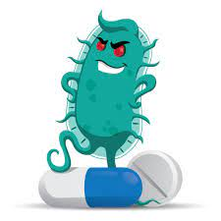
Subsection 5.2 in Practice
5.2.3, 5.2.4, and 5.2.5
These criteria are about policies and procedures that guide and inform practice
Policies and procedures that reflect best practice
How is IP involved with other aspects of clinical practice that require IP input
These criteria also make specific reference to pandemic and infectious disease response

Slide 14
Subsection 5.2 in Practice
5.2.6, 5.2.7 and 5.2.8
These criteria are related to IP education, procurement and consultation
IP education, how is this completed, how often and is there a plan?
Needs to be relevant to the organisational size and scope?
How is procurement completed and does IP have a voice in this process?
How is IP expertise sought for new builds and refurbishments?

Slide 15
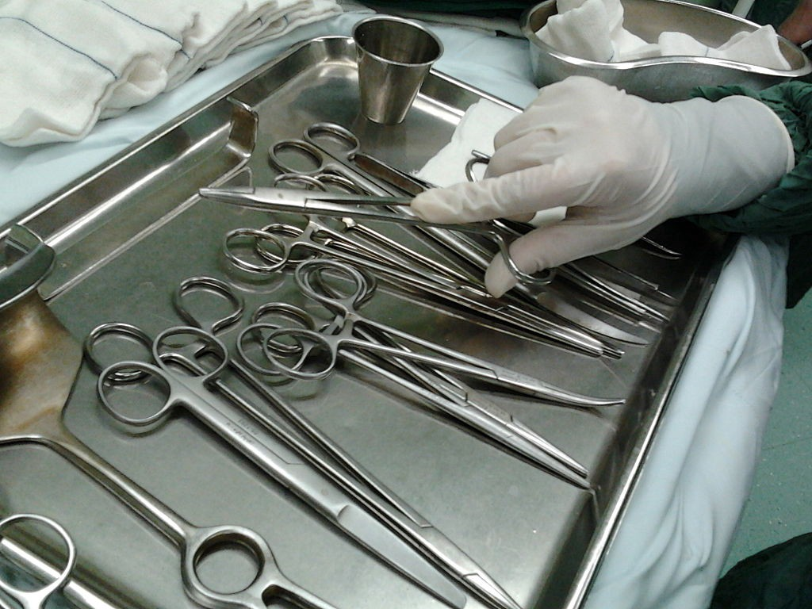
Subsection 5.2 in Practice
5.2.9, 5.2.10, 5.2.11, 5.2.12, and 5.2.13
The management of reusable medical devices
Appropriate and evidence-based cleaning and decontamination processes are completed
Policies and procedures to support this work
Single use is single use
Education resources in te reo Māori
Acknowledgment of participation and partnership with Māori
5.2.10 is not applicable to residential disability services/mental health and
addiction services
The
This Photo by Unknown Author is licensed under CC BY

Slide 16
Subsection 5.3 in Practice
Antimicrobial Stewardship Programme
‘We promote responsible antimicrobial prescribing and implement an AMS programme that is appropriate to the needs size and scope of the service’
5.3.1 is not applicable to residential disability and mental health and addictions

Slide 17
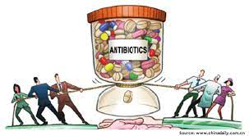
Subsection 5.3 in Practice
5.3.1, 5.3.2 and 5.3.3 applicable to ARC
Policies and procedures are evidence based
Appropriate to the size and scope of the service
Governance of the process
How is prescribing managed
Is there room for influencing practice
How are improvements going to be addressed and recognised

Slide 18
Subsection 5.4 in Practice
‘We carry out surveillance of HAI’s and multi-drug-resistant organisms in accordance with national and regional surveillance programmes, agreed objectives, priorities and methods specified in the infection prevention programme and with an equity focus’
Surveillance of infections

Slide 19
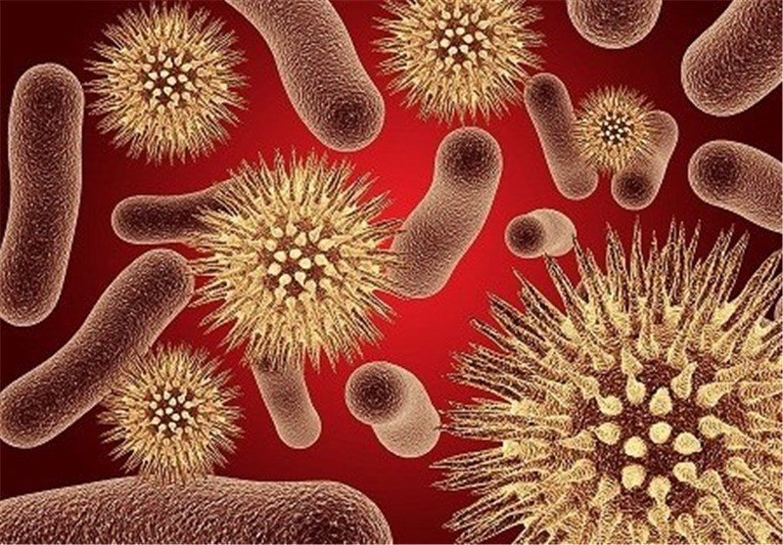
Subsection 5.4 in Practice
5.4.1 – 5.4.5
These criteria are about how surveillance of health care acquired infection is recorded and monitored
This is applicable to the size and scope of an organisation or facility
Focus needs to be on understanding the needs of your service and determining the right methods of surveillance
For public hospitals there is some guidance in national programmes around surgical site infections
Some private surgical hospitals conduct wound surveillance programmes
Is there analysis of surveillance data and how is it reported and acted on?
Are communication practices culturally safe?
Is ethnicity data being recorded for your organisation
5.4.3 is not applicable to fertility services
This Photo by Unknown Author is licensed under CC BY

Slide 20
Subsection 5.5 in Practice ‘We deliver services in a clean hygienic environment that facilitates the prevention of infection and transmission of antimicrobial organisms’ 5.5.1 – 5.5.5 are about the healthcare environment

Slide 21
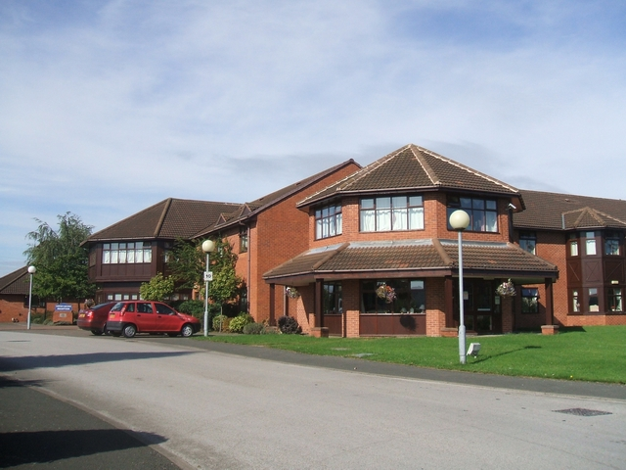
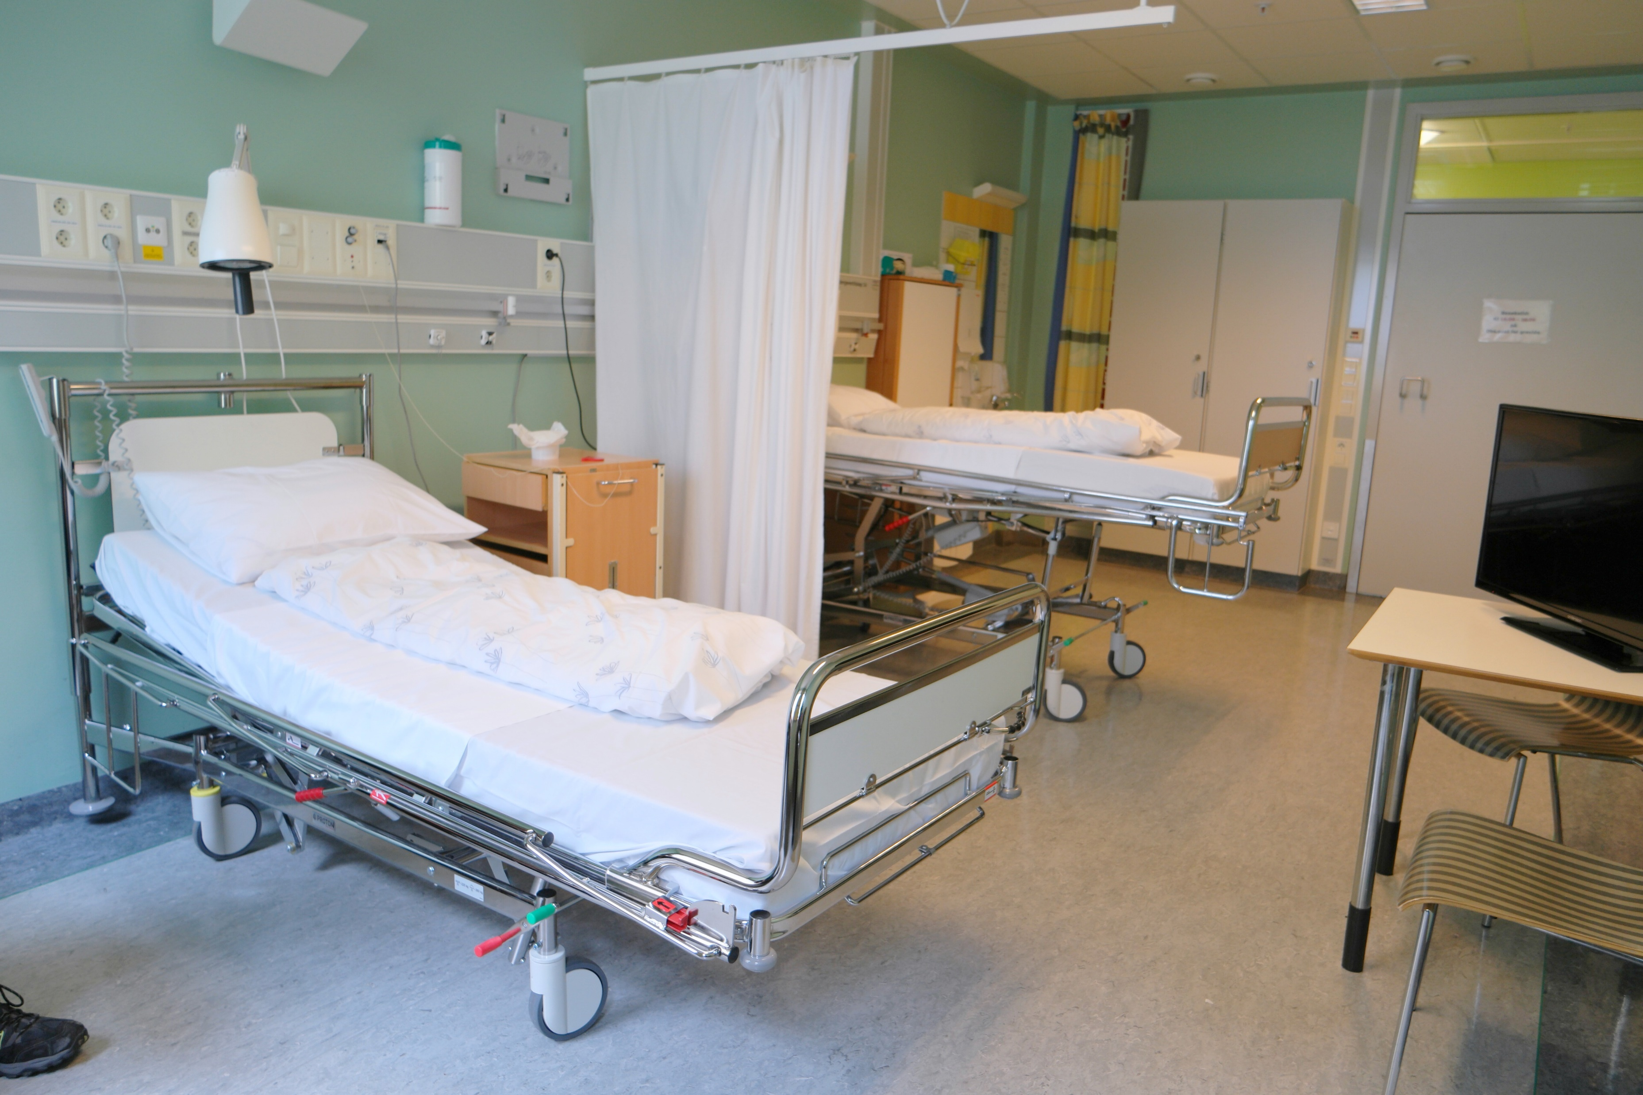
Subsection 5.5 in Practice
The environment where care is delivered
Practices related to safe handling and disposal of waste
Cleaning - how is this done, is there a policy to guide practice and how often is it reviewed?
Are cleaning audits completed and where are they reported to?
Safe handling and storage of laundry
What testing is completed for the environment and how is this reported and acted on?
This Photo by Unknown Author is licensed under CC BY-SA

Slide 22
Challenges for the sector
ARC and residential disability services
Size and scope of services varies
AMS and IP should to meet the needs of the residents receiving service

Slide 23
Ngā Mihi Nui
Thank you
Please direct any questions or queries to certification@health.govt.nz
Useful resources
NZS 8134:2021 Ngā Paerewa Health and Disability Services Standard
Sector Guidance for Ngā Paerewa Health and Disability Services Standard (NZS 8134:2021)
Standards Mapping Analysis 2021

