Slide 1
Ngā Paerewa Health and disability services standard 2021
Section 6: HERE TARATAHI / RESTRAINT AND SECLUSION
Thank you for attending this session. The session will start at 12.05 pm

Slide 2
Manatū Hauora Karakia
Whāia, whāia, whāia,
Ngā uaratanga o te Manatū Hauora.
Ko te manaakitanga
Ko te kaitiakitanga
Ko te whakapono
Ko te kōkiri ngātahi
Kia tae atu tātou ki pae tata, ki pae tawhiti, ki Pae Ora.
Kia tūturu ka whakamaua kia tīna, tīna!
Haumi e, hui e! Tāiki ē!
Let us jointly pursue the values of the Ministry of Health
We take care of each other
We create an environment for our people to thrive
We work in good faith
And we move forward together
If we do this, we will lay hold of distant horizons and those near to us, and we will create a thriving future for all people

Slide 3
Housekeeping
We are recording this session
  All sessions will be recorded and made available on the HealthCERT page on the Ministry website (under Training and support
We will be answering questions at the end of this presentation
We will be publishing these slides on our website

Slide 4

Introducing the
Ngā Paerewa Health and disability services standard 2021

Slide 5

The 2021 Standard
Published on 30 June 2021
Ministry has paid for free access. You can now download and print the 2021 standard for free.
Available here: https://www.standards.govt.nz/shop/nzs-81342021/

Slide 6
What we will be covering today
Quick context
  Mapping analysis
  Criteria application framework
  Sector Guidance
Section 6: HERE TARATAHI / RESTRAINT AND SECLUSION
Questions
Detailed overview available on our website:
https://www.health.govt.nz/our-work/regulation-health-and-disability-system/certification-health-care-services/services-standards/nga-paerewa-health-and-disability-services-standard

Slide 7
  Mapping analysis summary
HealthCERT has completed the official mapping of the 2008 Standards against the 2021 Standard.
The mapping is categorised into three elements:
  Mapped
    The 2021 criteria directly map to criteria in the 2008 HDSS. The criteria is either the same or has the same intent. The wording may differ slightly.
  Partially new/Partially mapped
    The 2021 criteria partially align to criteria in the 2008 HDSS. The 2021 criteria is either similar to current criteria or it is the same as most of the current criteria, but with an additional element. The wording likely differs to reflect current accepted best practice.
  New/Unmapped
    The 2021 criteria does not map to criteria in the 2008 HDSS. The criteria is a new requirement to the 2021 standard and has been added to assure safe services to New Zealanders that reflect updated models of care.
Notes:
This is the language we use throughout this presentation.

Slide 8
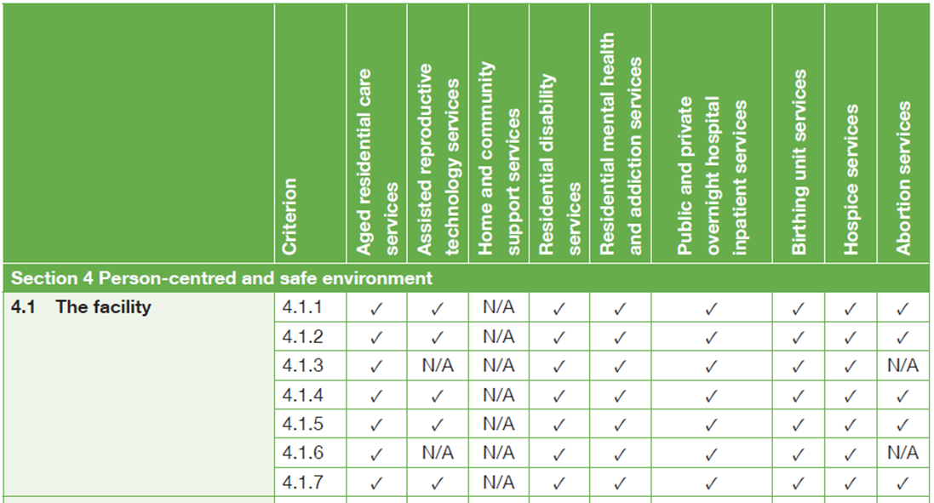
Criteria application
Not all criteria is applicable to all service types
Listed in the Sector Guidance document

Slide 9
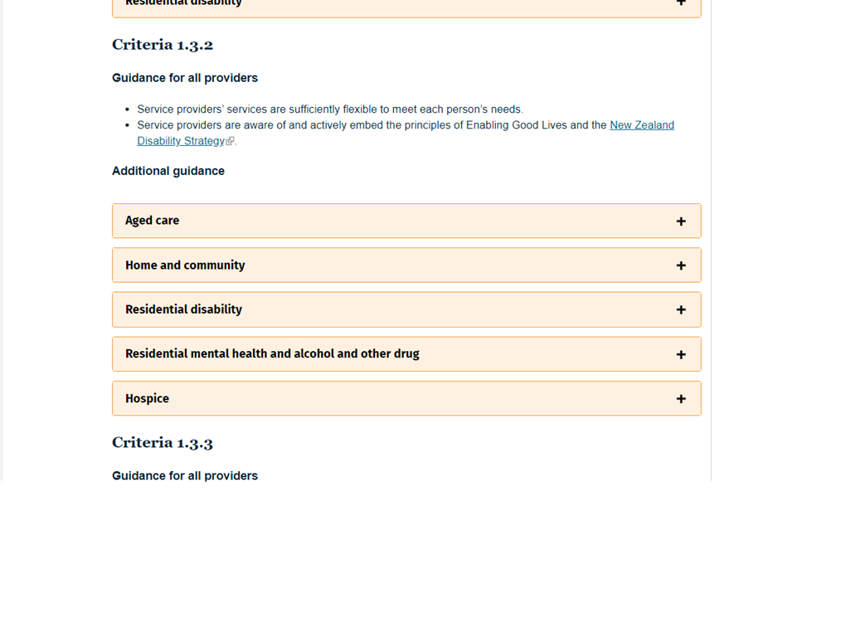
Sector Guidance
Ministry website
Support interpretation & implementation
Live document
Feedback from sector will inform updates
Easy to print as will adjust to your paper size
Notes:
https://www.health.govt.nz/our-work/regulation-health-and-disability-system/certification-health-care-services/services-standards/nga-paerewa-health-and-disability-services-standard/sector-guidance-nga-paerewa-health-and-disability-services-standard-nzs-81342021

Slide 10
Implementation/Transition Plan
Staged, Transparent, Non-punitive Approach
New (unmapped) and partially new (partially mapped) criteria will have grace periods before full implementation required.
Audit Pilot: The pilot will include a variety of service and audit types
Purpose: To test implementation processes against the Ngā Paerewa 2021 Standard.
When: August through to November 2021.
Who: Providers and DAAs can volunteer to take part.
How: Watch for updates to come on specifics of audit pilot framework.
Resources:
Developing an online e-learning module to support providers with the updated Te Tiriti content of the Standard
Re-establishing the HealthCERT Bulletin
DAA Handbook will be updated to align with the Ngā Paerewa 2021 Standard
Feedback from the sector to inform implementation:
Regular implementation stakeholder surveys will be available to feed into the implementation activities and workshops
Events/Forums
Let HealthCERT know if you have an event, forum or national/regional meeting you think would be useful for HealthCERT to attend.
Notes:
a short grace period (6-12 months) for partially mapped criteria
a longer grace period for new/unmapped criteria (12-18months)
Mapped criteria will continue to be audited. Awarding of attainment should be in alignment with current audit practice.

Slide 11
Standard Implementation
Section 6: Here Taratahi/ seclusion and restraint
6.1 He tukanga here / A process of restraint | 2021 Edition
Subsections | 4 Subsections (new language)
Criteria | 24
Not applicable criteria | 0
Partially new criteria | 2
Not mapped (new) | 6

Slide 12
Section 6: HERE TARATAHI / RESTRAINT AND SECLUSION
Outcome 6: "Services shall aim for a restraint and seclusion free environment, in which people’s dignity and mana are maintained.“
Subsection
6.1 He tukanga here / A process of restraint (6 criteria)
6.2 Herenga haumaru / Safe restraint (8 criteria)
6.3 Arotake kounga o te herenga / Quality review of restraint (1 criterion)
6.4 Taratahi / Seclusion (9 criteria)
Notes:
What do we want to cover in the section headlines?

Slide 13
6.1 He tukanga here / A process of restraint
HDSS 2008 Alignment: 2.1 Restraint Minimisation
Criteria | Criteria Description 2021 | HDSS 2008 | HCSS | Fertility | Abortion | Applicability
6.1.1 | Governance bodies shall demonstrate commitment toward eliminating restraint. | Partially mapped: not explicit/aligns with 2.1.1 | N/A | N/A | N/A | Applicable to the following service types only: ARC Residential Disability – ID/PD/Sensory Residential Disability – MH/AOD DHB inpatient/Private Hospitals Hospice
6.1.2 | Service providers shall demonstrate a commitment to ensuring the voice of people with lived experience, Māori and whānau, is evident on the restraint oversight groups. | Not mapped
6.1.2 | Service providers shall demonstrate a commitment to ensuring the voice of people with lived experience, Māori and whānau, is evident on the restraint oversight groups. | Not mapped |  |  |  | Applicable to the following service types only: Residential Disability –ID/PD/Sensory Residential Disability – MH/AOD DHB inpatient/Private Hospitals
6.1.3 | There shall be an executive leader who is responsible for ensuring the commitment to restraint minimisation and elimination is implemented and maintained. | Partially mapped: not explicit/aligns with 2.1.1 |  |  |  | Applicable to the following service types only: ARC Residential Disability – ID/PD/Sensory Residential Disability – MH/AOD DHB inpatient/Private Hospitals Hospice
6.1.4 | Executive leaders shall report restraint used at defined intervals and aggregated restraint data, including the type and frequency of restraint, to governance bodies. Data analysis shall support the implementation of an agreed strategy to ensure the health and safety of people and health care and support workers. | Not mapped
6.1.5 | Service providers shall implement policies and procedures underpinned by best practice that shall include: The process of holistic assessment of the person’s care or support plan. The policy or procedure shall inform the delivery of services to avoid the use of restraint; The process of approval and review of de-escalation methods, the types of restraint used, and the duration of restraint used by the service provider; Restraint elimination and use of alternative interventions shall be incorporated into relevant policies, including those on procurement processes, clinical trials, and use of equipment. | 2.1.1; 2.1.2; 2.2.1.1; 2.2.1.2
6.1.6 | Health care and support workers shall be trained in least restrictive practice, safe practice, the use of restraint, alternative cultural-specific interventions, and de-escalation techniques within a culture of continuous learning. | 1.3.6.3; 2.1.5; 2.2.2.1; 2.2.3.6
Notes:
Home and Community Support Sector Standard NZS 8185:2021 criteria

Slide 14
6.1 He tukanga here / A process of restraint cont...
Criteria Description | Sector Guidance for all providers | Applicability
6. 1.1 (Partially new) Governance bodies shall demonstrate commitment toward eliminating restraint. | No general guidance for all providers. Service Type Specific Guidance available on the website: ARC Residential Disability – ID/PD/Sensory Residential Disability – MH/AOD DHB inpatient/Private Hospitals Hospice | Applicable to the following service types only: ARC Residential Disability – ID/PD/Sensory Residential Disability – MH/AOD DHB inpatient/Private Hospitals Hospice
6.1.2 (New) Service providers shall demonstrate a commitment to ensuring the voice of people with lived experience, Māori and whānau, is evident on the restraint oversight groups. | No general guidance for all providers. Service Type Specific Guidance available on the website: Residential Disability – ID/PD/Sensory Residential Disability – MH/AOD DHB inpatient/Private Hospitals | Applicable to the following service types only: Residential Disability –ID/PD/Sensory Residential Disability – MH/AOD DHB inpatient/Private Hospitals

Slide 15
6.1 He tukanga here / A process of restraint cont...
Criteria Description | Sector Guidance for all providers | Applicability
6.1.3 (Partially new) There shall be an executive leader who is responsible for ensuring the commitment to restraint minimisation and elimination is implemented and maintained. | No general guidance for all providers. Service Type Specific Guidance available on the website: ARC Residential Disability – ID/PD/Sensory Residential Disability – MH/AOD DHB inpatient/Private Hospitals Hospice | Applicable to the following service types only: ARC Residential Disability – ID/PD/Sensory Residential Disability – MH/AOD DHB inpatient/Private Hospitals Hospice
6.1.4 (New) Executive leaders shall report restraint used at defined intervals and aggregated restraint data, including the type and frequency of restraint, to governance bodies. Data analysis shall support the implementation of an agreed strategy to ensure the health and safety of people and health care and support workers. | No general guidance for all providers. Service Type Specific Guidance available on the website: ARC Residential Disability – ID/PD/Sensory Residential Disability – MH/AOD DHB inpatient/Private Hospitals Hospice

Slide 16
6.2 Herenga haumaru / Safe restraint
HDSS 2008 Alignment: 2.2 Safe Restraint Practice
Criteria | Criteria Description 2021 | HDSS 2008 | HCSS | Fertility | Abortion | Applicability
6.2.1 | The decision to approve restraint for a person receiving services shall be made: As a last resort, after all other interventions or de-escalation strategies have been tried or implemented; After adequate time has been given for cultural assessment; Following assessment, planning, and preparation, which includes available resources able to be put in place; By the most appropriate health professional; When the environment is appropriate and safe. | 1.3.6.3; 2.1.2; 2.2.2.1; 2.2.3.2 | N/A | N/A | N/A | Applicable to the following service types only: ARC Residential Disability – ID/PD/Sensory Residential Disability – MH/AOD DHB inpatient/Private Hospitals Hospice
6.2.2 | The frequency and extent of monitoring of people during restraint shall be determined by a registered health professional and implemented according to this determination. | 2.2.3.1; 2.2.3.3
6.2.3 | Monitoring restraint shall include people’s cultural, physical, psychological, and psychosocial needs, and shall address wairuatanga. | 2.2.3.1; 2.2.3.3; 2.2.3.4
6.2.4 | Each episode of restraint shall be documented on a restraint register and in people’s records in sufficient detail to provide an accurate rationale for use, intervention, duration, and outcome of the restraint, and shall include: (a) The type of restraint used; (b) Details of the reasons for initiating the restraint; (c) The decision-making process, including details of de-escalation techniques and alternative interventions that were attempted or considered prior to the use of restraint; (d) If required, details of any advocacy and support offered, provided, or facilitated; NOTE – An advocate may be: whānau, friend, Māori services, Pacific services, interpreter, personal or family advisor, or independent advocate. (e) The outcome of the restraint; (f) Any impact, injury, and trauma on the person as a result of the use of restraint; (g) Observations and monitoring of the person during the restraint; (h) Comments resulting from the evaluation of the restraint; (i) If relevant to the service: a record of the person-centred debrief, including a debrief by someone with lived experience (if appropriate and agreed to by the person). This shall document any support offered after the restraint, particularly where trauma has occurred (for example, psychological or cultural trauma). | 2.1.1; 2.2.1.2; 2.2.3.4; 2.2.3.5

Slide 17
6.2 Herenga haumaru / Safe restraint cont…
Criteria | Criteria Description 2021 | HDSS 2008 | HCSS | Fertility | Abortion | Applicability
6.2.5 | A person-centered debrief shall follow every episode of emergency restraint. Participation in this debrief shall be determined by the person when they feel ready. | 2.2.4.1; 2.2.4.2; 2.2.4 | N/A | N/A | N/A | Applicable to the following service types only: ARC Residential Disability – ID/PD/Sensory Residential Disability – MH/AOD DHB inpatient/Private Hospitals Hospice
6.2.6 | Service providers shall consider who is the most appropriate member of the work force to debrief the person. | Not mapped
6.2.7 | Each episode of restraint shall be evaluated, and service providers shall consider: Time intervals between the debrief process and evaluation processes shall be determined by the nature and risk of the restraint being used; The type of restraint used; Whether the person’s care or support plan, and advance directives or preferences, where in place, were followed; The impact the restraint had on the person. This shall inform changes to the person’s care or support plan, resulting from the person-centered and whānau centered approach/reflections debrief; The impact the restraint had on others (for example, health care and support workers, whānau, and other people); The duration of the restraint episode and whether this was the least amount of time required; Evidence that other de-escalation options were explored; Whether appropriate advocacy or support was provided or facilitated; Whether the observations and monitoring were adequate and maintained the safety of the person; Future options to avoid the use of restraint; Suggested changes or additions to de-escalation education for health care and support workers; The outcomes of the person-centered debrief; Review or modification required to the person’s care or support plan in collaboration with the person and whānau; A review of health care and support workers’ requirements (for example, whether there was adequate senior staffing, whether there were patterns in staffing that indicated a specific health care and support workers issue, and whether health care and support workers were culturally competent). | 1.3.6.3; 2.2.3.1; 2.2.4.1; 2.2.4.2
6.2.8 | Health care and support workers shall have the opportunity to be involved in a timely debrief following seclusion or restraint events. | 2.2.4.1; 2.2.4.3; 2.2.5.1 |  |  |  | Not applicable to ARC, Fertility, HCSS; Birthing & Abortion

Slide 18
6.2 Herenga haumaru / Safe restraint cont…
Criteria Description | Sector Guidance for all providers | Applicability
6.2.6 (New) Service providers shall consider who is the most appropriate member of the workforce to debrief the person. | No general guidance for all providers. Service Type Specific Guidance available on the website: ARC Residential Disability – ID/PD/Sensory Residential Disability – MH/AOD DHB inpatient/Private Hospitals | Applicable to the following service types only: ARC Residential Disability – ID/PD/Sensory Residential Disability – MH/AOD DHB inpatient/Private Hospitals Hospice

Slide 19
6.3 Arotake kounga o te herenga / Quality review of restraint
HDSS 2008 Alignment: 2.5 Restraint Monitoring and Quality Review
Criteria | Criteria Description 2021 | HDSS 2008 | HCSS | Fertility | Abortion | Applicability
6.3.1 | Service providers shall conduct comprehensive reviews at least six-monthly of all restraint practices used by the service, including: That a human rights-based approach underpins the review process; The extent of restraint, the types of restraint being used, and any trends; Mitigating and managing the risk to people and health care and support workers; Progress towards eliminating restraint and development of alternatives to using restraint; Adverse outcomes; Compliance with policies and procedures, and whether changes are required; Whether the approved restraint is necessary; safe; of an appropriate duration; and in accordance with the person’s and health care and support workers’ feedback and current evidenced-based best practice; If the person’s care or support plans identified alternative techniques to restraint; The person and whānau, perspectives are documented as part of the comprehensive review; Consideration of the role of whānau at the onset and evaluation of restraint; Data collection and analysis (including identifying changes to care or support plans and documenting and analysing learnings from each event); Service provider initiatives and approaches support a restraint-free environment; The outcome of the review is reported to the governance body. | 2.2.1.3; 2.2.5.1 | N/A | N/A | N/A | Applicable to the following service types only: ARC Residential Disability – ID/PD/Sensory Residential Disability – MH/AOD DHB inpatient/Private Hospitals Hospice

Slide 20
6.4 Taratahi / Seclusion
HDSS 2008 Alignment: 2.3 Seclusion
Criteria | Criteria Description 2021 | HDSS 2008 | HCSS | Fertility | Abortion | Applicability
6.4.1 | Service providers shall work towards being seclusion free. | Not Mapped | N/A | N/A | N/A | Applicable to the following service types only: Residential Disability – ID Public Hospital
6.4.2 | Seclusion data shall be provided to governing bodies on a monthly basis, and strategies to support the elimination of seclusion shall be agreed and implemented. | Not Mapped
6.4.3 | Service providers have policies and procedures that are based on national guidelines and aligned to the current legislation. | 2.3.1.1; 2.3.1.3
6.4.4 | Seclusion shall only take place in a designated and approved room. | 2.3.2.1; 2.3.2.2; 2.3.2.3; 2.3.2.4
6.4.5 | A person- and whānau-centred debrief shall follow every seclusion event, according to best practice. A person- and whānau-centred approach involves reflections of the event (including opportunities to input strategies to prevent seclusion being used again). Service providers shall apply what they have learnt from events and make changes to current safety care or support plans to add what is required to avoid seclusion. | 2.2.4.3; 2.3.1.4; 2.3.1.5
6.4.6 | Each seclusion event shall be evaluated as soon as reasonably possible after the event. The evaluation is undertaken by registered health professionals from at least two different disciplines and a Māori or Pacific cultural advisor and lived experience advisor, where available, and shall consider: Whether the person’s care or support plan and advance directives and preferences, where in place, were followed; The impact the seclusion had on the person, other people using the service, and health care and support workers; The duration of the seclusion event and whether this was the least amount of time required; What alternative interventions were considered, why any were not used, and therefore why seclusion was the option of last resort; Whether appropriate advocacy or support was sought, provided, or facilitated; Whether the observations and monitoring were adequate and maintained the safety of the person; Future options to eliminate seclusion; Any suggested changes or additions to seclusion education for health care and support workers; The outcomes of the person- and whānau-centred debrief; Review or modification required to the person’s care or support plan in collaboration with the person. | 2.2.4.1; 2.3.1.4; 2.3.1.5

Slide 21
6.4 Taratahi / Seclusion cont...
Criteria | Criteria Description 2021 | HDSS 2008 | HCSS | Fertility | Abortion | Applicability
6.4.7 | Service providers shall conduct comprehensive reviews at least six-monthly of all seclusion events, to determine how the service is working towards or maintaining zero seclusion, to determine: That a human rights-based approach underpins the review process; The number of people secluded, the number of episodes of seclusion, their duration, demographics, and any trends; Mitigating and managing the risk to the person, other people in the environment ,and health care and support workers; Progress towards eliminating seclusion, and development of the many alternatives to using seclusion; Adverse outcomes; Compliance with policies and procedures, and whether changes are required; Whether there are additional education or training needs, or changes required to existing seclusion-elimination education; Service provider initiatives, and approaches that support and will achieve zero seclusion. The outcome of the review shall be reported to the governance body. | 2.2.5.1 | N/A | N/A | N/A | Applicable to the following service types only: Residential Disability – ID Public Hospital
6.4.8 | Health care and support workers have the opportunity to be involved in a wider debrief or discussion following significant incidents supporting wellbeing to maximise learning from the evaluation of the seclusion event and to ensure safety for all in an environment of zero seclusion. | 2.2.4.1; 2.2.4.3; 2.2.5.1
6.4.9 | Night safety orders shall be recognised as a restrictive practice. | Not Mapped

Slide 22
6.4 Taratahi / Seclusion cont...
Criteria Description | Sector Guidance for all providers | Applicability
6.4.1 (New) Service providers shall work towards being seclusion free. | Service providers only use seclusion as a last resort and when there is an assessed imminent risk to the safety of the person and all others involved. | Applicable to the following service types only: Residential Disability – ID Public Hospital
6.4.2 (New) Seclusion data shall be provided to governing bodies on a monthly basis, and strategies to support the elimination of seclusion shall be agreed and implemented. | Data includes: rationale and clinical review number of people secluded number of seclusion events demographics duration of seclusion events in hours any personal restraints taken in order to achieve the seclusion any specific issues related to each seclusion event.
6.4.9 (New) Night safety orders shall be recognised as a restrictive practice. | For guidance on night orders, see Ministry of Health (2018) Night Safety Procedures: Transitional guideline.

Slide 23
Indicative Implementation timeline
NZS 8134: 2021 Ngā paerewa Health & Disability Services Standard
Standard NZ Board approval
Minister
of Health approves Standard
for use
Sector engagement
Online workshops
Lunchtime sessions for each section
Piloting the 2021 Standard
30 June
Standard and Sector guidance published
Targeted sessions & conferences
Targeted workshops based on feedback
For each service type (eg ARC, RESDIS)
DAAs
People, whānau, consumer organisations
Māori health providers
28 February 2022
Standard in effect
May 2021
Jun
2021
Jul
2021
Aug 2021
Sep 2021
Oct 2021
Nov 2021
Dec 2021
Jan 2022
Feb 2022
Mar
2022

Slide 24
Questions?

Slide 25
Manatū Hauora Karakia
Whāia, whāia, whāia,
Ngā uaratanga o te Manatū Hauora.
Ko te manaakitanga
Ko te kaitiakitanga
Ko te whakapono
Ko te kōkiri ngātahi
Kia tae atu tātou ki pae tata, ki pae tawhiti, ki Pae Ora.
Kia tūturu ka whakamaua kia tīna, tīna!
Haumi e, hui e! Tāiki ē!
Let us jointly pursue the values of the Ministry of Health
We take care of each other
We create an environment for our people to thrive
We work in good faith
And we move forward together
If we do this, we will lay hold of distant horizons and those near to us, and we will create a thriving future for all people

